Slide 1
Planning and Starting your Master Thesis for students of the M. Sc. /Cand. Merc. in Global Marketing and Consumer Culture Brand Management and Marketing Communication (and Market Anthropology)
Søren Askegaard
Department of Marketing & Management
Consumption, Culture & Commerce

Slide 2
Key Take-Aways
Start early
Consider writing in groups
Use what you learned in your core courses (Marketing Theory, Marketing Across Cultures, Consumption Studies,..)

Slide 3
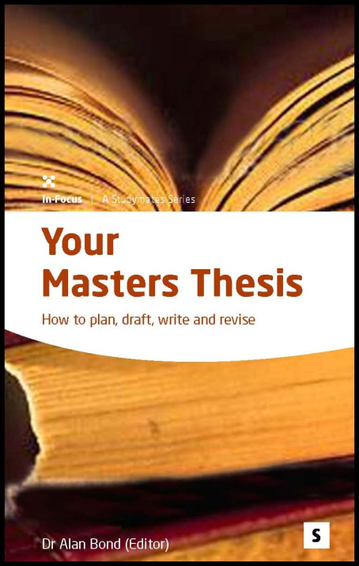
The master thesis in BMMC & GMC
Your chance to go deep-diving
You design, implement and describe an independent scientific work.
Finding a suitable topic and supervisor is your task
An exam where YOU pick the question you have to answer
Academic freedom ←→ Strict deadlines!

Slide 4
Scope
“A problem that is relevant for the profile by applying theories and methods that are characteristic of the profile.”
The thesis must use “theory that builds on or extends the knowledge which the student has attained in compulsory courses” of the profile.
BMMC/GMC: typically cultural/sociological theories applied to marketing or consumer behavior
often, but not only qualitative research methods (ethnographies, interview studies, netnography, discourse analysis, semiotics,… ) applied to marketing or consumer behavior

Slide 5
Writing with a company
Generally a great idea & many do it successfully
But also an additional challenge
Be aware that supervisors and companies look for different things in a thesis (e.g. theory vs. practical suggestions)
Remember to stay in touch with your supervisor if e.g. the company’s plans/needs change (they often do)
It can be a good idea to prepare a final presentation/report for the company and write the thesis as a separate document
Make sure in advance that you will have enough time to actually write the thesis!
Make sure in advance that you will have access to the data (e.g. interview partners) you will need

Slide 6
What you cannot do
Work for a company and write a report
Write (only) a business or marketing plan
Write an opinion piece
Only collect and present data without a theory-laden interpretation
Use only/primarily Bachelor-level literature (4P, SWOT, etc.)
Use theories or methods that your supervisor cannot understand

Slide 7
The proposal
Proposals must contain: 1. topic, 2. research question, 3. methodology incl. type of data, and 4. the theory/perspective you want to use. Be precise.
If something is missing, you can be rejected and have to re-submit
Details can be changed later during the supervision! You are only suggesting a concrete idea, not defining exactly what you will write!

Slide 8
Finding a topic
Possible starting points:
An idea or phenomenon
A supervisor & his/her research
A text or theory
A data set

Slide 9
Topic proposals on the profile homepage

Slide 10
Typical mistakes in proposals
Too broad: “I will write about the internet.”
Nothing new: “I want to find out if social media are important to consumers.”
The question cannot be answered using the data you plan to collect: “I will study the sub-consciousness of consumers by reading newspaper articles.”
Only basic Bachelor-level theories are suggested; not content form the master courses
Too similar to a thesis that has already been written by someone else. (We check this!)
Theory or methodology are missing

Slide 11
The course Syllabi are a perfect starting point for your literature search

Slide 12
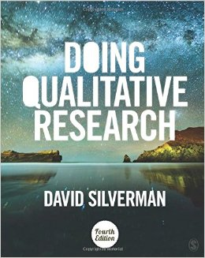
Remember what you have learned … or get a textbook.
Market Ethnography
Other methodological skills

Slide 13
Asking a supervisor by e-Mail
If you want to talk in person or on the phone, email professors first to set up a date
Be precise & short!
Allow about a week for a response
Send a reminder after a week
Only say it is urgent if it really is urgent – give a reason
Don’t over-interpret short replies

Slide 14
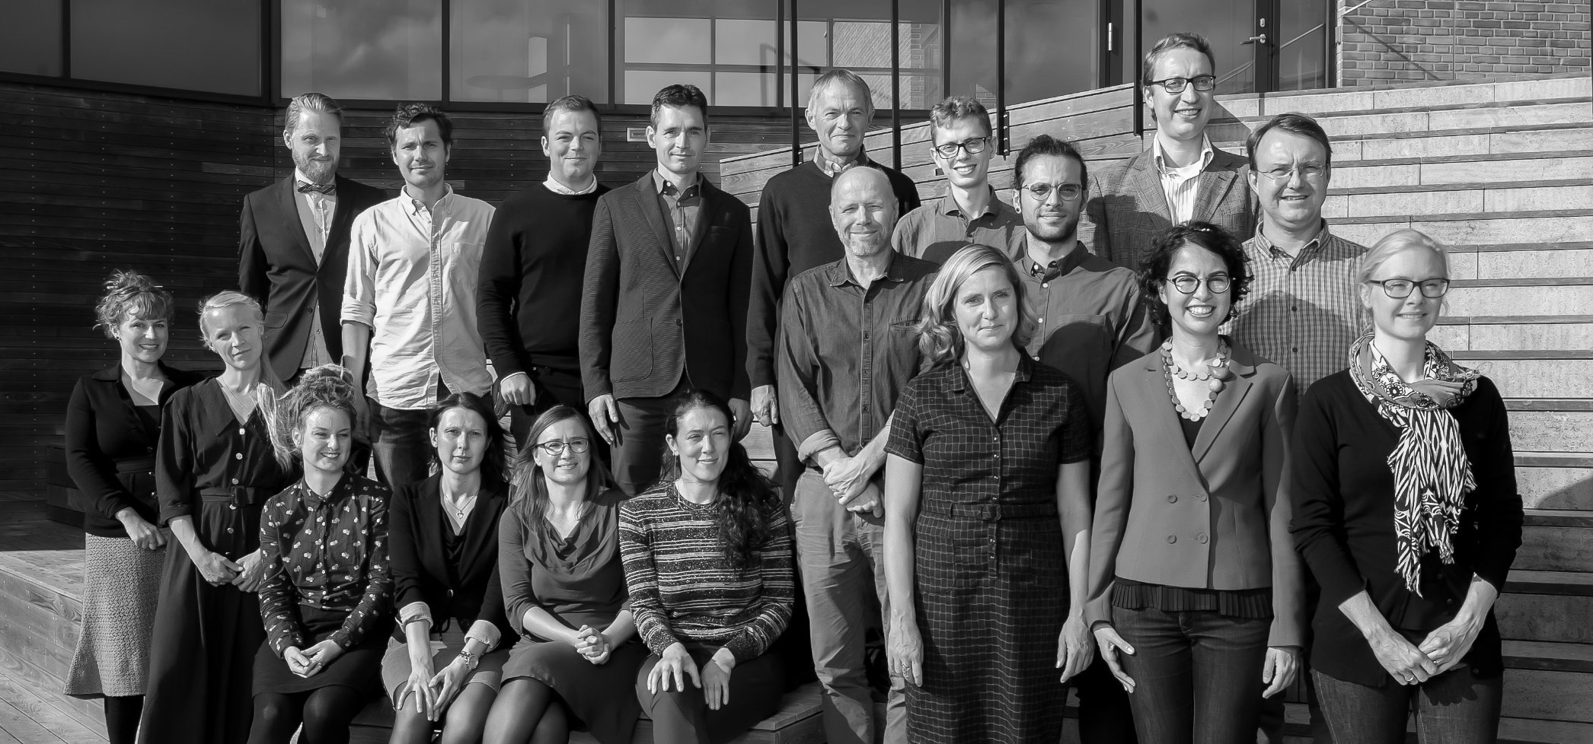
The Research Group Consumption Culture and Commerce
Research interests of the group members: https://www.sdu.dk/en/om_sdu/institutter_centre/i_marketing/forskning/forskerprofiler/ccc

Slide 15
The tragedy of the uninspiring thesis
A student start off with a great idea...
... collects rich and deep data...
... but does not really know how to analyse it to find something new/non-commonsensical.
So he turns to Google Scholar, using the wrong (descriptive) keywords...
... and clicks on the results at the top – usually old psychology papers proposing simplistic theories (these accumulate most citations over the decades).
He then tries to analyze rich qualitative data with simplistic, cause-effect theories designed for a differnt purpose.
His conculsions are commonsensical, and the methodology flawed. Everybody goes home disapoinnted. ☹

Slide 16
Can you imagine yourself getting a PhD?

Slide 17
Still questions? → Academic student Advisors
Telephone: 6550 3191 (only during office hours) Fax: 6550 5692
Collective email inbox: vejledning.merc.od@sam.sdu.dk
You can find your Academic Student Advisors behind the counter at the Student Information Point.

Slide 18
… and don’t forget to have fun!

