Slide 1
How to establish a Master’s Thesis cooperation with a company
Kaya Louise Birch – Student Career counselor

Slide 2
Why work with a company?
Network
Practical experience
Learning about competences (this is what I can do)
Notes:
So why work with a company in your master thesis?
When you work with a company, you can use the academic skills you have gotten trough your master, and you will work with them in practice. You will learn about the skills and competencies that a company search for, and will be better suited to understand, what is it you have learned over the years.
There are also some other bonusses like network, and you will know what your competences are, when you need to write a CV and motivational letter, but that is not why i am here today.

Slide 3
But remember!
Academic challenge
Not a student job
A relevant problem statement
Think about your method choses
Notes:
Remember that you are academics, and have to solve an academic challange when writing your master thesis in cooperation with a company, it is not a student job where you are just working,
The problemstatement has to be relevant, both for you and the company.
Think about your method chooses, a method that is relevant for you and the company, so the company has something to gain by choosing to do a cooperation with you. And also again that you will get to use your academic skills.

Slide 4
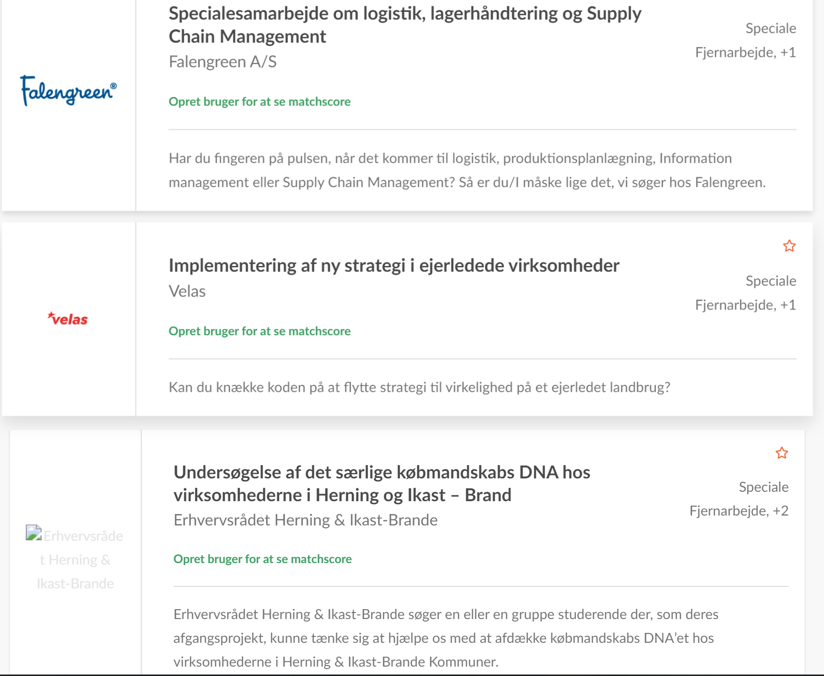
How do you find and contact a company regarding a thesis cooperation?
Find a company
Thesis cooperation
www.jobbank.sdu.dk
Fairs
Most companies are interested in having a critical look on their processes
Notes:
You can find companies on SDU Jobbank, remember that the companies who have choosen to put something in the jobbank, is a company who hos chosen to use time to explain a selected subject, but you are more than welcome to contact other companies in there, who maybe are searching for some to do an internship og student job, because maybe you have an idea that is relevant for thoose companies.
I have just typed in thesis in the search engine, and found these 3.
You could also go to fairs og online business lunch. But fairs are a good way to get in contact with companies and pitch yourselves and maybe an idea. The relevant thing is that you are open and looking at different places to find company, and also maybe you have someone in your network that can help you.
I know it can be hard to make the first contact, but the the more you know what you wanna wright about, it is easier to make a pitch. We will also be on the fairs and online lunches, so if you get there and dont know how to go over to the companies, come and talk to us, and maybe we can help you come up with some ideas.

Slide 5
How to make contact?
What are the most interesting things to know – from perspective of the company?
What do we gain?
What does it cost us?
Why do you wanna work with us? – (why them, not why you)
Be aware that a thesis-cooperation is not a job offer and talking about it might discourage them
Notes:
When you make contact, there are something that are more interesting for the company to know.
What do the company gain?
What does it cost them?
Why do you wanna work with them, and not why they should work with you.
Dont pitch it as they could get a usefull employee out of it, be more specific about the thesis you wanna write, and what that could potentialy gain for them.

Slide 6
Align expectations
Before, during and after
What does the company need to deliver?
What kind of resources do you need?
Available data – don’t get trapped in something ongoing!
Notes:
So it’s important when you find a company, that you align expectations. What is it that the company has to deliver? What kind resources do you need? Just remember not to get trapped, use data that is already available, so you are not waiting for material and data that can be pushed beacause of deadlines. Maybe some companies has something that is ongoing right now, that you find super relevant, but just be sure that you are able to get the data that you need. And you dont get them the day before you have to deliver the master thesis.
Also remember to be specific, who has this assignment? You. Who has to get something out of this paper? Proberbly both. Juts remember to ask the company what they want afterwards, is it a powerpoint presentation? Or is it 10 bullitpoints for improvement?
Aligning expectations is a good way to be sure that both of you know what you are getting out of this cooperation.

Slide 7
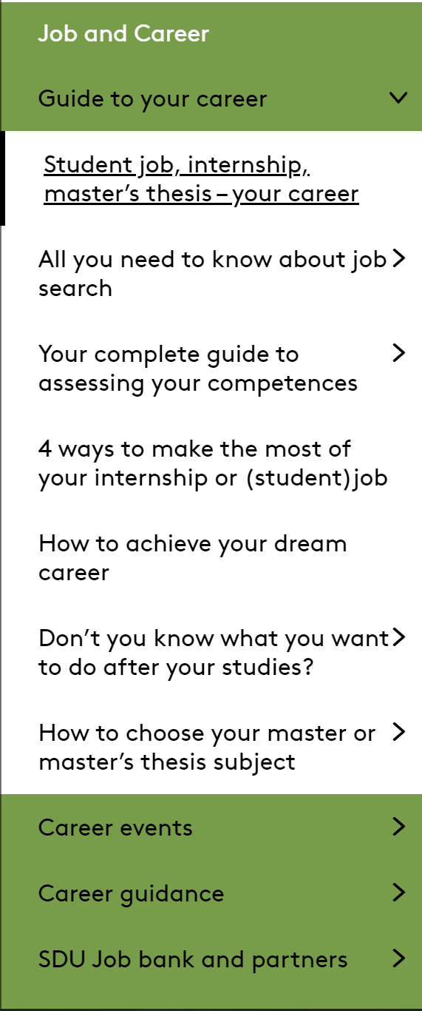
Mitsdu.dk/karriere
Notes:
So at mitsdu.dk/karriere under the student job, internship and master’s thesis, you can find an agrement you can fill out with the company, so you have everything in writing, what is the cooperation about, what do you need from the company and etc. you can also find the NDA – non disclusure aggrement.
And help on the webpage about cv, motivational letter, how to aapproach the company etc.

Slide 8
If you need help
Book a career conversation at minkarriere.sdu.dk
Help with writing your CV and cover letter
Where to search for companies
How to approach companies
Notes:
or you more than welcome to book a career conversation, to talk more about finding a company, can you look other places, and also writing a motivational letter og cv, or in someother way you get stuck in the process.
You are more than welcome to contact us.
Questions?

