Slide 1

Planning and Starting your Master Thesis
Victor Martin-Sanchez, Ph.D.
Course responsible
Department of Business & Management

Slide 2

AGENDA
Main points from the course description
  Aim and purpose
  Learning goals
  Content
The proposal
Handing in
Oral defense
Important dates
Plagiarism or self-plagiarism
Questions

Slide 3
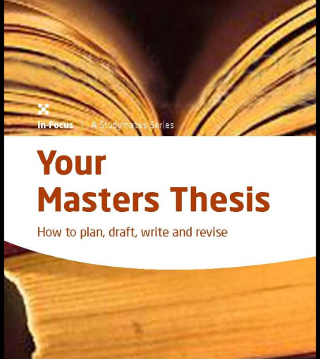
THE MASTER THESIS
Your chance to go deep-diving
You design, implement and describe an independent scientific work.
Finding a suitable topic and supervisor is your task
An exam where YOU pick the question you have to answer
Academic freedom, but strict deadlines!

Slide 4
COURSE DESCRIPTION AND PURPOSE
The objective of the Master's thesis’ is that the student obtains an opportunity to demonstrate that he or she independently and professionally can define, delimit, analyze, assess and solve a problem within the profile's area in a way that is relevant to stakeholders.
The thesis problem must be suitable for developing and demonstrating the ability to produce knowledge on a high level
and thus allow the student to use scientific knowledge and methods as well as other qualifications acquired in the study program.

Slide 5
Course desciption: Learning goals
Formulate A WELL-STRUCTURED, PRECISE AND UNAMBIGUOUS PROBLEM which is realistic in relation to the available resources for the project.
IDENTIFY AND SELECT A RELEVANT THEORETICAL FOUNDATION for analysis of the problem. The theoretical foundation should build on or extend the knowledge which the student has attained in compulsory courses. The selected foundation should include the significant theories and sources within the thesis subject area.
DESIGN AND CONDUCT AN ANALYSIS (RESEARCH) of the research questions related to the problem. This is done by application of methods from the profile – theoretical or empirical – to ensure that the analysis and the solution/findings adhere to academic standards of the subject area.
PRESENT THE RESULTS of the analysis and their documentation as well as reflect on their quality and potential for generalizations.
CHOOSE THE RELEVANT ALTERNATIVE/CONCLUDE ON THE RESEARCH QUESTIONS based on the results of the research performed under consideration of relevant ethical dilemmas and environmental and other relevant consequences.
COMMUNICATE THE RESULTS IN A CLEAR AND WELL-STRUCTURED FORM in a written report and an oral presentation with the University's lecturers as the target audience as well as to non-specialists by selecting and communicating the most significant components in a concise manner in an abstract.

Slide 6

SCOPE
“A problem that is relevant for the profile by applying theories and methods that are characteristic of the profile.”
The thesis must use “theory that builds on or extends the knowledge which the student has attained in compulsory courses” of the profile.
Reflect on the knowledge gained during the work on the Master’s Thesis in relation to the problem at hand and in general in relation to the theory of the subject area including new literature within the area.
The topic of the thesis must be within a subject area covered in one of the mandatory courses (not elective)

Slide 7
What you cannot do
Write (only) a business or marketing plan
2
Write an opinion piece
3
Only collect and present data without a theory-laden interpretation
4
Use only/primarily Bachelor-level literature (4P, SWOT, etc.)
5
Use theories or methods that your supervisor cannot understand
6
Work for a company and write (just) a job report. The thesis remains a scientific paper
1

Slide 8

The proposal
Proposals must contain:
    1. topic,
    2. research question,
    3. methodology incl. type of data, and
    4. the theory/perspective you want to use.
    Be precise.
If something is missing, you can be rejected and must re-submit
Details can be changed later during the supervision. You are only suggesting a concrete idea, not defining exactly what you will write!

Slide 9
Common mistakes in proposals
Too broad: “I will write about the internet.”
Nothing new: “I want to find out if social media are important to consumers.”
The question cannot be answered using the data you plan to collect: “I will study the sub-consciousness of consumers by reading newspaper articles.”
Only basic Bachelor-level theories are suggested; not content from the master courses
Too similar to a thesis that has already been written by someone else. (We check this!)
Theory or methodology are missing

Slide 10


Writing with a company
Generally a great idea & many do it successfully
But also an additional challenge
Be aware that supervisors and companies look for different things in a thesis (e.g., theory vs. practical suggestions)
Remember to stay in touch with your supervisor if e.g., the company’s plans/needs change (they often do)
It can be a good idea to prepare a final presentation/report for the company and write the thesis as a separate document
Make sure in advance that you will have enough time to write the thesis!
Make sure in advance that you will have access to the data (e.g., interview partners) you will need

Slide 11

Working on your thesis….
Work on your thesis according to the/your plan
  Supervision
  Library resources
  Formalities for written assignments
  Course description

Slide 12

Handing in
On time
If you miss the deadline and need extra examination attempt
What happens if you do not pass
See course description

Slide 13

Oral defense
Individually or in group
An external examiner (censor), internal examiner (supervisor) and you
Start by presenting your work – if questions to your presentation please contact your supervisor
Questions and discussions

Slide 14

Important dates
Register your wish for topic/supervisor (Nov 1st)
Enroll for the course Master's thesis.
  20-30 Nov
  If you have passed 60 ECTS (when start working on your Master thesis)
You are assigned a supervisor (December 1st)
Get approval of the supervisor agreement (before January 15th)
Please check your student mail, homepage, and itslearning.
https://mitsdu.dk/en/mit_studie/kandidat/candmerc_odense/speciale

Slide 15

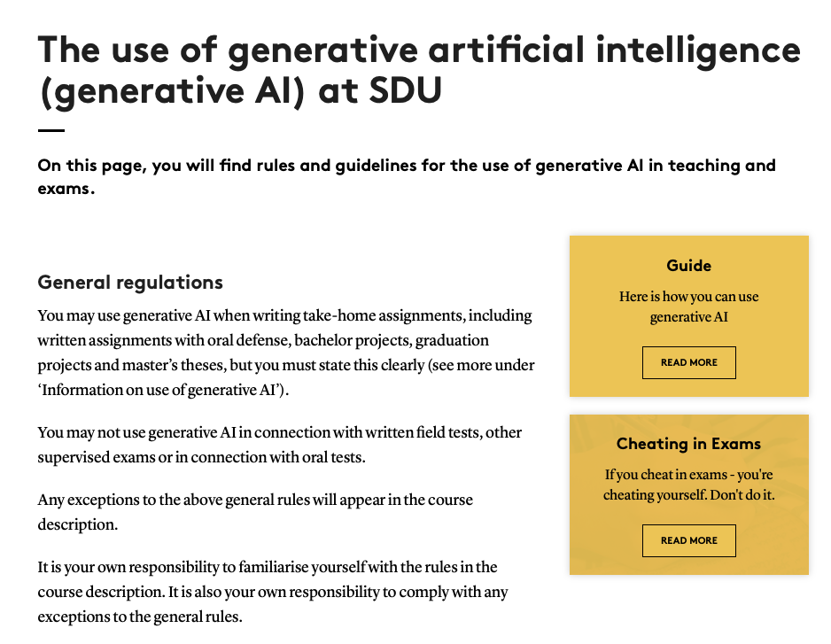
Beware of plagiarism or self-plagiarism & the use of GenAI

Slide 16
Still questions
Exam Team Business Economics / Eksamensteam – Erhvervsøkonomi
Telephone: +45 65 50 22 90 (only during office hours)
Collective email inbox: Exam.merc.od@sam.sdu.dk
Exam Team & the Academic Student Advisors
Telephone: +45 65 50 22 90 (only during office hours)
Collective email inbox: Contact through spoc
You can find your Academic Student Advisors behind the counter at the Student Information Point
Questions about AI:
  https://mitsdu.dk/en/mit_studie/kandidat/candmerc_odense/vejledning-og-support/aipaasdu

Slide 17
Key take-aways
Start early, plan well
Consider writing in groups
Carefully read: https://mitsdu.dk/en/mit_studie/kandidat/candmerc_odense/speciale
Formalities for written assignments: https://mitsdu.dk/en/mit_studie/kandidat/candmerc_odense/eksamen/faa-styr-paa-eksamen/formalia
Beware of plagiarism & the use of GenAI: https://mitsdu.dk/en/mit_studie/kandidat/candmerc_odense/vejledning-og-support/aipaasdu

Slide 18

Questions

