Slide 1
Writing a M.Sc.Thesis in HRM: important choices along the way
Elena Shulzhenko, PhD
Profile Director for Cand. Merc. HRM
Department of Business and Management

Slide 2
Agenda
Choices along the thesis writing process
Choosing a supervisor
Choosing and developing a research question
Questions
What is a master thesis?

Slide 3
What is a master thesis?
30 ECTS – a product that takes 810 hours of work
The thesis is 60-80 standard pages long for one student
(excluding table of contents, bibliography and appendices)
The thesis is 90-110 standard pages long for two student
(excluding table of contents, bibliography and appendices)
This is likely to become the longest text you will have written in your life!

Slide 4
Choices along the thesis writing process
Empirical vs. theoretical thesis
Area / topic / research question (RQ)
NB: You must write about HRM / organisational behaviour
Individual thesis vs. two students’ thesis
Supervisor
Qualitative vs. quantitative methods

Slide 5
Empirical thesis
RQ addresses an empirical problem
RQ should be formulated using the chosen concepts and theories
Choice of company or organisation is important: justify what larger population the company represents
Reflect about the context of the company (private/public sector, industry, location, labour market situation etc.)
Reflect about the characteristics of the company (size, age, MNC/local business etc.)

Slide 6
Theoretical thesis:
RQ addresses a theoretical problem
Inconsistency in theories
Deviations of the empirical observations from theoretical predictions
It does not exclude collection and analysis of primary data
There is no theoretical thesis without a theoretical RQ or puzzle: ”just” a literature review is not enough

Slide 7
Choosing a supervisor

Slide 8
Choosing a supervisor
You have a free choice of a supervisor, but not all professors at the department will have time available for supervision
You might consider having plans A and B
The research group with a lot of researchers interested in HRM and organisation studies is International Leadership and Management (ILM)
The list of topics of some of ILM researchers follows

Slide 9
Assoc. Prof. Ingo Winkler (ILM)
Happy to supervise any topic within the area of HRM / organisational behaviour
These are the topics of his particular interest – either stand-alone or related to HRM function:
Leadership
Emotional labour
Emotional intelligence
Organizational identification
Gender, age, and other forms of diversity

Slide 10
Assoc. Prof. Mette Lund Kristensen (ILM)
Happy to supervise any topic within the following areas:
organisational behaviour
(critical) management studies
organizational communication
She is particularly interested in the following concepts:
organizational identification identity
liminality (ambiguous transitional phases)
paradoxes

Slide 11
Assoc. Prof. Elke Weik (ILM)
Happy to supervise within the area of HRM/organisation studies
She prefers the students to develop a topic

Slide 12
Assoc. Prof. Elena Shulzhenko (ILM)
Happy to supervise within the broad area of HRM and organisational behaviour
Topics of particular interest:
international HRM
future of work incl. digitalisation of work and AI
employee perspectives in general (wellbeing and resilience)
organisational change, voice and resistance to change

Slide 13
Choosing and developing a research question

Slide 14
Problem statement and research question
Problem formulation is central to any investigation; it evolves over time
A problem formulation should ideally arise from a sense of wonder or a puzzle – something that one does not understand.
A problem formulation can easily be based on a topic that, in everyday understanding, is not at all “problematic” – the puzzle is of an intellectual nature
Different theoretical perspectives will lead to different types of problem formulations.
RQ should not have an answer easy to foresee without any research

Slide 15
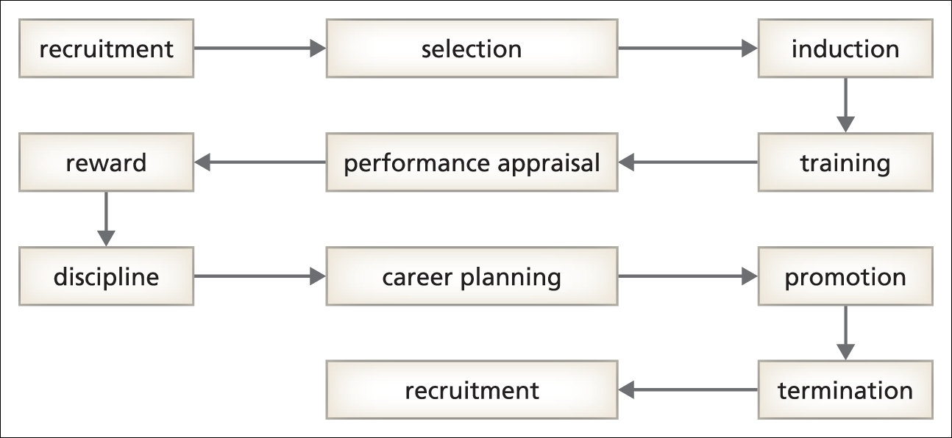
The employment cycle and societal context (Source: Huczynski and Buchanan 2013)
Societal changes
E. e. ageing workforce, generational differences
Technological changes
E.g. AI in HRM, surveillance, gamification
Cultural changes
E.g. multicultural workforce
Political changes
E. g. equal pay regulation in EU, environmental regulations

Slide 16
One way of approaching the choice of RQ
Future impact stemming from personal values – what difference do I want to make for others through my work?
Topic – what do I want to get to know better? What is relevant for an organization/company I am in contact with?
Wonder/puzzle – what question within the topic does not have a definitive answer in the literature?

Slide 17
Future impact stemming from values - some examples
Eliminate or reduce injustice
Equal opportunities, reducing discrimination
Reduce irrationality in decisions
Overcoming dependence from the past outdated policies
Novelty: discover or verify some new ways of doing things
AI in HRM

Slide 18
Example of a problem statement and RQ: ”Motivation Behind Volunteerism: Keeping the Volunteers in Non-profit Organisations”
The problem examined in this paper is the difficulty of keeping volunteers in the nonprofit
organizations. As seen in the introduction, high turnover is a problem in volunteer
organizations. There are a lot of consequences of high turnover; therefore, volunteer organizations
must aim for more long-term volunteers, in order to keep the organization stable.
In order to examine how to avoid high turnover, this paper seeks to answer the following question: “What can
we learn about long-term volunteering from the case of ABC?”
In order to examine this question, the following research questions are examined:
1. Why are volunteers joining ABC?
2. Why are volunteers continuing in ABC?

Slide 19
Questions or comments?

