Slide 1
Masters’ Thesis Introduction
GMCC & BMMC
Anuja Anil Pradhan, PhD
01/10/2024

Slide 2
Agenda
General Information
01
Problem Formulation
02
Finding your Topic
03
Examples
04
Contacting a supervisor
05
Q&A
06

Slide 3
But First – Check Odin
This Photo by Unknown Author is licensed under CC BY-ND

Slide 4
General Information
Start early
Consider writing in groups
Use what you’ve learned in your courses

Slide 5
Problem formulation
Your chance to go on a deep-dive – what do you find interesting?
How is this relevant to your profile?
Is there a possibility of an industry collaboration?
You are in charge
Design, implement and describe an independent scientific work
Find a suitable topic and a supervisor
An opportunity for an exam where YOU pick the question you have to answer

Slide 6
Problem formulation
“A problem that is relevant for the profile by applying theories and methods that are characteristic of the profile.”
The thesis must use “theory that builds on or extends the knowledge which the student has attained in compulsory courses” of the profile.
Typically, cultural/sociological theories applied to marketing or consumer behaviour
Qualitative research methods - ethnographies, interview studies, netnography, - applied to marketing or consumer behaviour

Slide 7
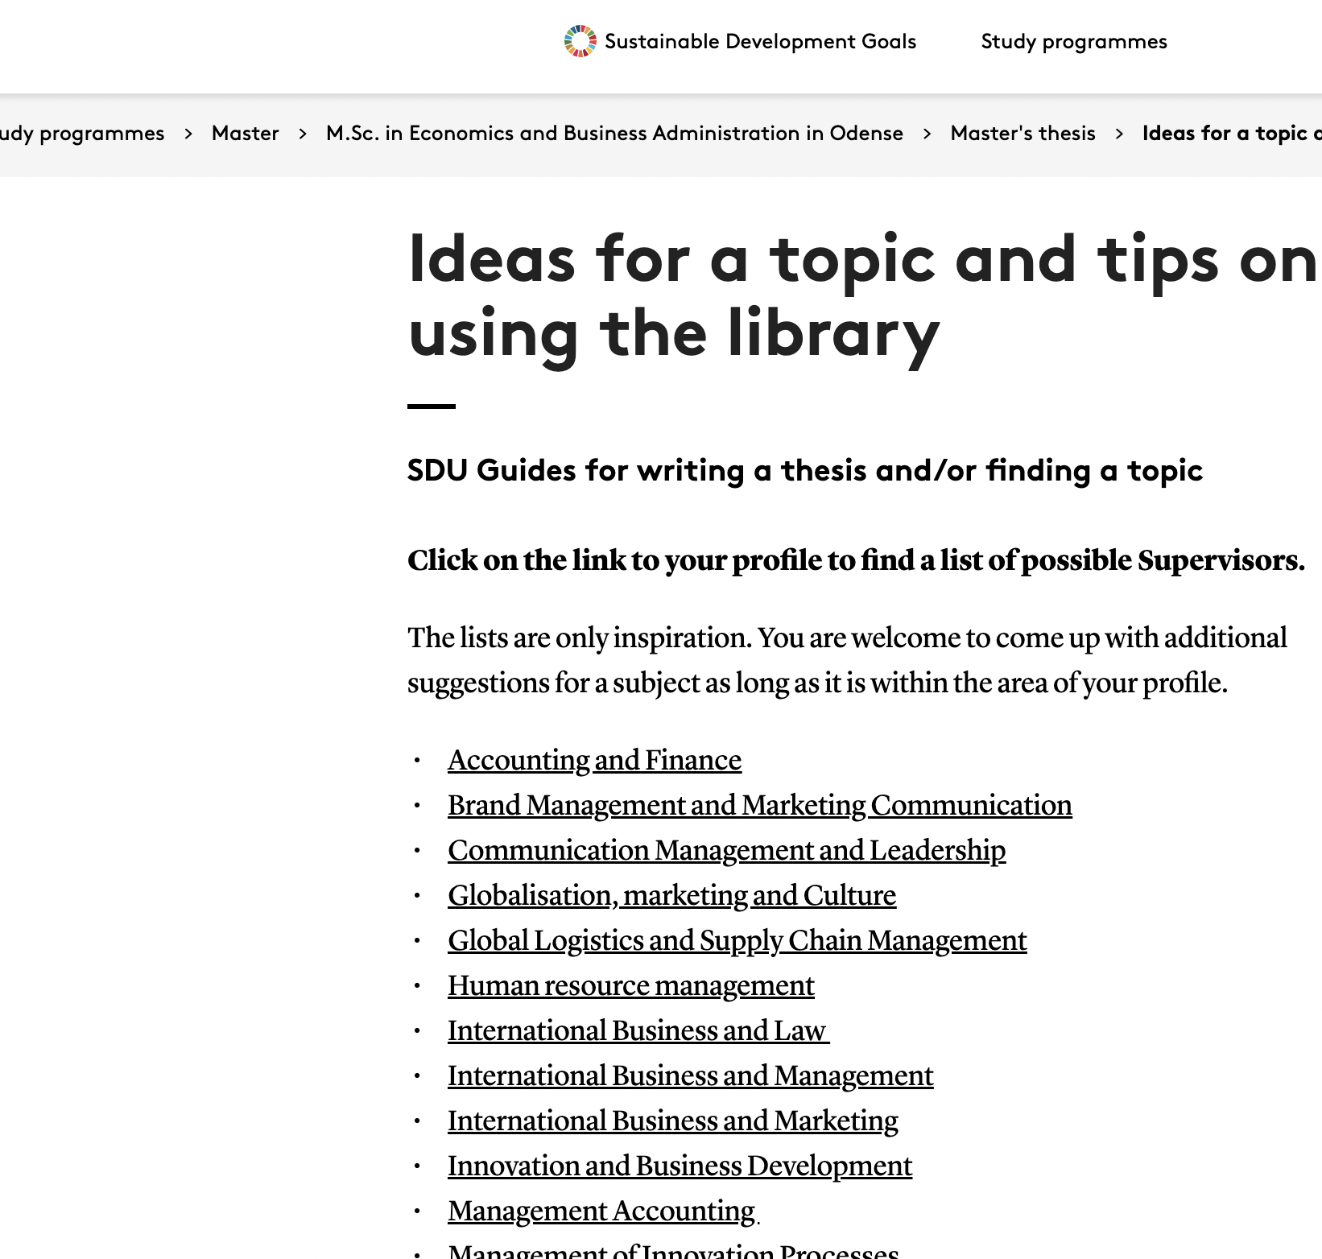
Finding your topic
Phenomenon
Supervisor’s research (check CCC group website)
Theory
Data
Syllabus
https://mitsdu.dk/en/mit_studie/kandidat/candmerc_odense/speciale/ideer_og_kilder

Slide 8
The Proposal
Must include:
Topic
Research question
Method
Theory
Details can be changed later during the supervision! You are only suggesting an idea, not defining exactly what you will write!

Slide 9
Topic Examples
Speciality coffee marketplace in Tanzania
The focus of the thesis will be regarding the consumption and culture of coffee in a producing nation; Tanzania, where the results therefrom will be compared to with ones from the global north; Denmark.
We would like to understand and uncover how coffee as a global commodity has become such a luxury product that it is today, through the lenses of Consumption Studies, Marketing Across Culture, Globalization Processes and Marketing Theory.
We will conduct Ethnographic research (In-depth interview + observation) in Tanzania to gather primary data, which we intend to compare with Danish secondary data in order to make a comparative analysis of their coffee consumption and culture.

Slide 10
Topic Examples
Speciality coffee marketplace in Tanzania
The focus of the thesis will be regarding the consumption and culture of coffee in a producing nation; Tanzania, where the results therefrom will be compared to with ones from the global north; Denmark.
We would like to understand and uncover how coffee as a global commodity has become such a luxury product that it is today, through the lenses of Consumption Studies, Marketing Across Culture, Globalization Processes and Marketing Theory.
We will conduct Ethnographic research (In-depth interview + observation) in Tanzania to gather primary data, which we intend to compare with Danish secondary data in order to make a comparative analysis of their coffee consumption and culture.

Slide 11
Topic Examples
Topic: Formula 1 is a traditionally male-dominated sport in its participants and fandom, and recently has become bigger and gained more female fans. Due to the male dominance female fans tend to be stigmatised by the male fans. This research wants to understand how women interact and participate with the f1 fandom, knowing that they are stigmatised. This will be researched in the context of social media.
Research questions: How do female f1 fans participate in the f1 fandom? How do female fans navigate the stigma associated with female fans in the f1 fandom?
Methods - Interviews: interviews with women who are fans of f1 and use social media to understand why they use social media, how they experience stigmatisation and to understand how this affects them. Netnography: to see what the content is that is created by women fans of f1 on different social media platforms as well as understand what kind of content is popular among female fans. To understand how stigmatisation is visible on social media
Theories: Articulation theory: to understand how female fans articulate themselves on different social media platforms. Social identity theory: to understand what is the relation between what and who fans socially identify with and their femininity, in terms of teams, drivers and other fans

Slide 12
Topic Examples
Why do consumers appreciate craft beers?
What role does marketing communications play in the investment gender gap?
How do adult fans understand their identities in relationship to Disney princesses?
What are the consumption markers of adulthood for Gen Z consumers?
How are practices like clothes swapping influencing sustainability?

Slide 13
Contacting a potential supervisor
Email a potential supervisor if you have an idea they might like
Be concise
Don’t shop around
Don’t misinterpret short responses

Slide 14
Questions? (not my dog)

