Slide 1
Short introduction on how to find a project organization & Career Management Skills
Tine Lynfort Jensen
Career Counselor, SDU RIO

Slide 2
Why choose a Project and Trainee Period?
Hands-on experience applying theory to practice
Concrete working experiences and awareness of your own competences and how you can contribute to an organization (private, public, NGO…)
Insight into organizations and job functions
Understanding business processes, what kind of taks suits you, career possibilities
Develop and expand your professional network
Also an opportunity to collaborate beyond the period
Develop your CV
Sharpen your academic and professional profile - experience counts in the eyes of potential employers

Slide 3
What would you like to gain from a Project & Trainee Period?
Reflections about choosing your project organization:
Need to find an organization and tasks that matches your study profile
Is there a specific subject-related area you would like to work with in a practical setting? (e.g. marketing, Human Resources, strategy, etc)
Is there a specific business area or sector you would like to learn more about? (e.g. robot, gaming, financial industry, etc)
Size of organization – small, medium, big, global?
Type of organization – private, public, NGO or…?
Where – close to home or…?
Are you already part of an organization that might be relevant?

Slide 4
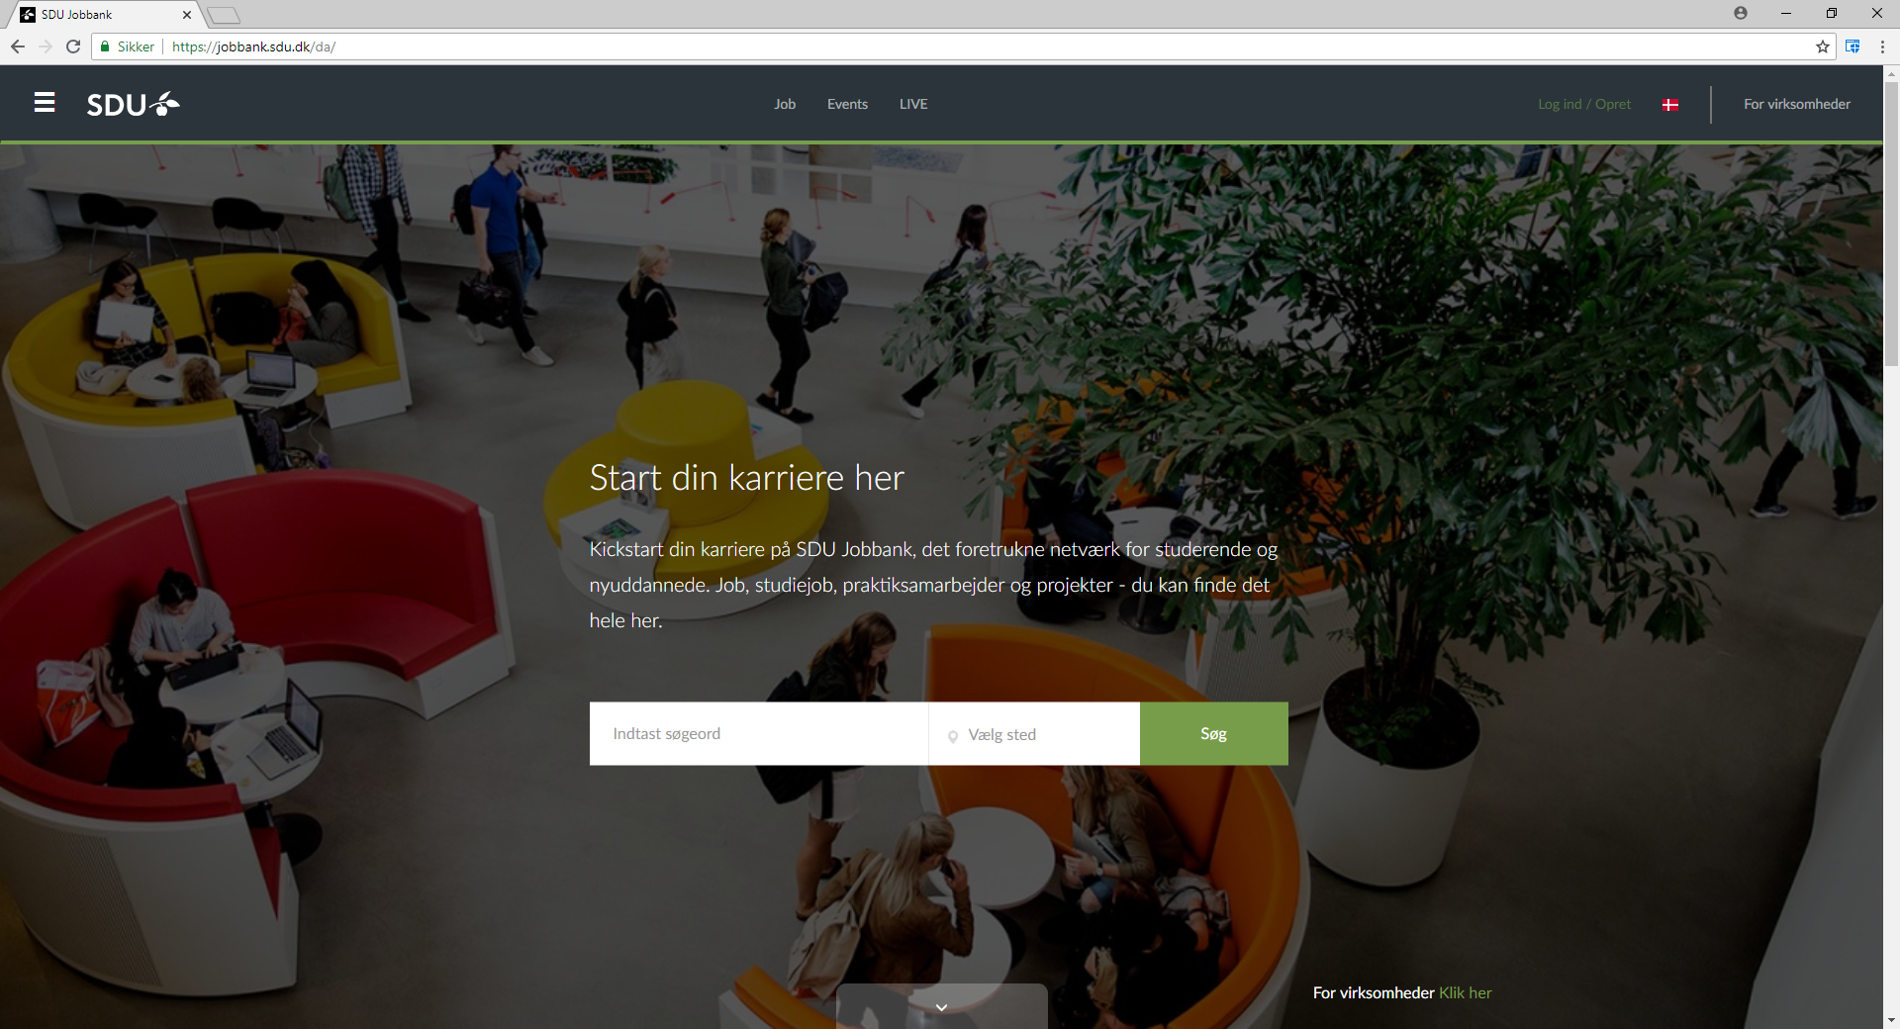
SDU Jobbank: jobbank.sdu.dk
New student jobs, internships and projects every week.

Slide 5
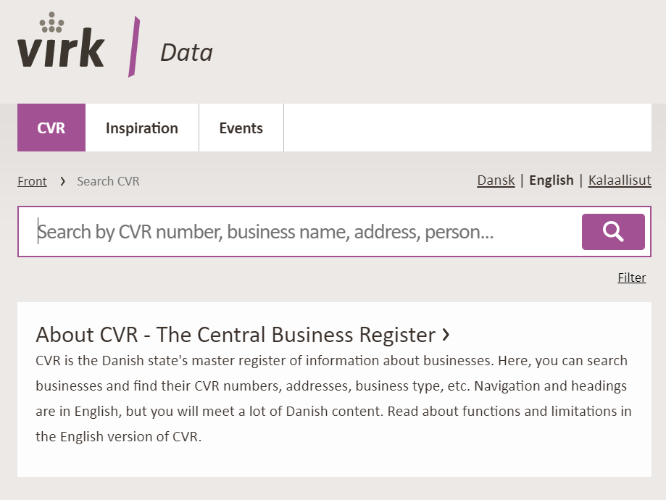
Apply unsolicited – do your own reseach
SDU Jobbank
Also look at student jobs, projects and full time positions – possible openings
Other job portals, eg. Jobindex
LinkedIn: companies and other cand.merc.-candidates
Alumnet, SDU: find alumni that could help you
National and local media
Databases – the library can help
Use your existing private and professional network
Notes:
LinkedIn:
Søg på virksomheder eller på HA/Cand.merc-dimittender.
Kig geografisk bredt og søg uopfordret

Slide 6
How can the Career Counselors help you?
Get feedback and inputs on your thoughts:
Where and how do I find relevant postings and organizations?
How do I contact an organization?
How do I communicate my competences?
How do I write a targeted application and CV?
How do I prepare for a dialogue with the organization?
How do I find out what’s right for me?
Book a talk with us at mitsdu.dk/job&career

Slide 7
Career Management Skills

Slide 8
What is Career Management Skills?
An online 4 module course in connection to your Project and Trainee Period
Facilitated by a Career Counselor from SDU RIO
The purpose of the course is:
Inspire you to get the most out of your project period
Increase your chances of getting a job after graduation
Prepare you to make decisions about your career
Topics centered around your experiences in your project organization
Competences
Networking
Career strategies and tools to apply for jobs

Slide 9
From the Course Description (10, 20 ECTS)
During the project-oriented study, the student must participate in a series of workshops on Career Management Skills. The aim and purpose of the workshops is to initiate a process of career learning and personal development where the students practice connecting theory and subject-related terms to a practical context.
Throughout the Career Management Skills modules, the students will bring their competences and resources to action in their project company as well as reflect on their experiences during the semester. The themes of the course include knowledge on competences, awareness of one’s own competences, network and cooperative relations, strategy and planning as well as an understanding of the current and future labour market

Slide 10
How is it organized?
Weekly tasks – individual and collaborative
Reflections, discussions in Itslearning room
Activities in your project organization - hands on experience with the topics from the course
Feedback and interaction with fellow students and SDU RIO consultant
Active participation – minimum 3 out of 4 modules and work actively with tasks

Slide 11
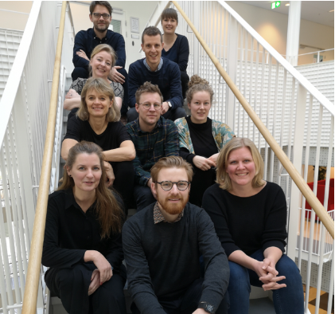
Thank you – and hope to see you again!
Tine Lynfort Jensen
lynfort@sdu.dk
The Career Counseling at SDU
karriere@sdu.dk
https://mitsdu.dk/en/rio
Meet us in Zone E at Gydehutten every day 10-14

