Slide 1
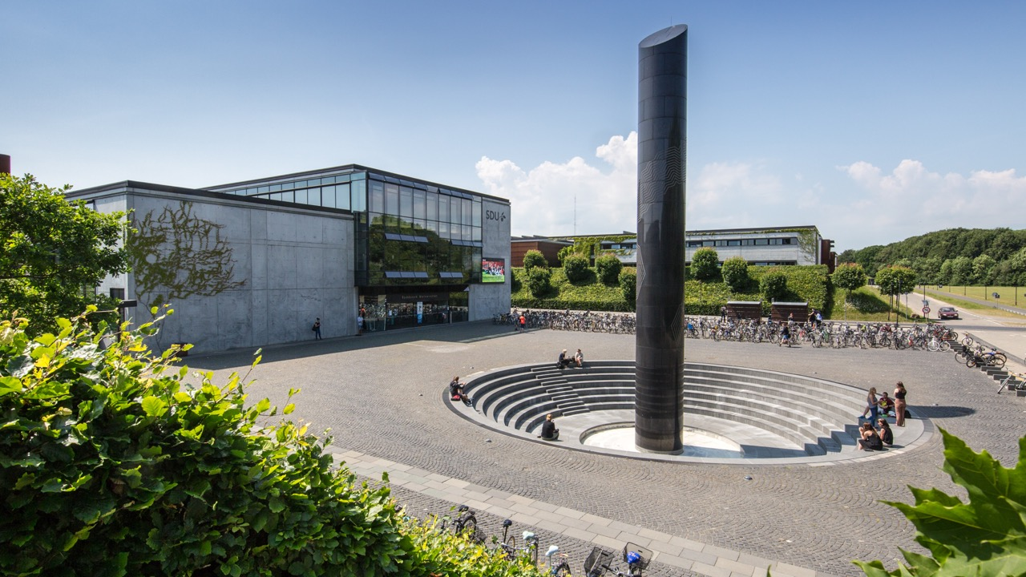
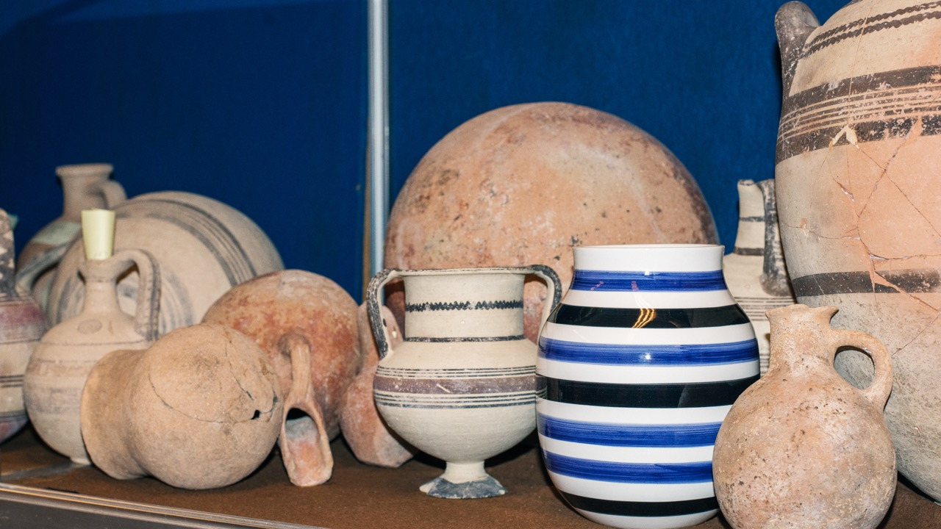

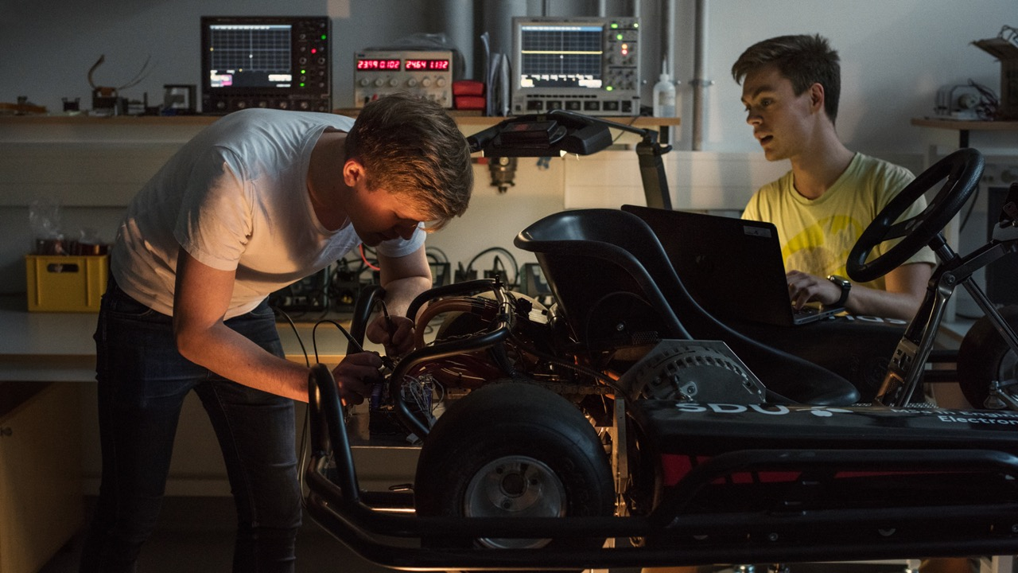
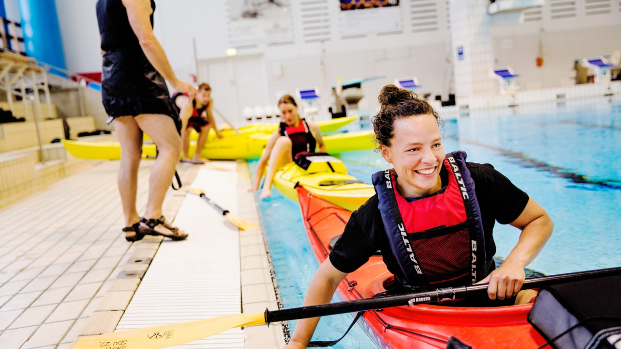
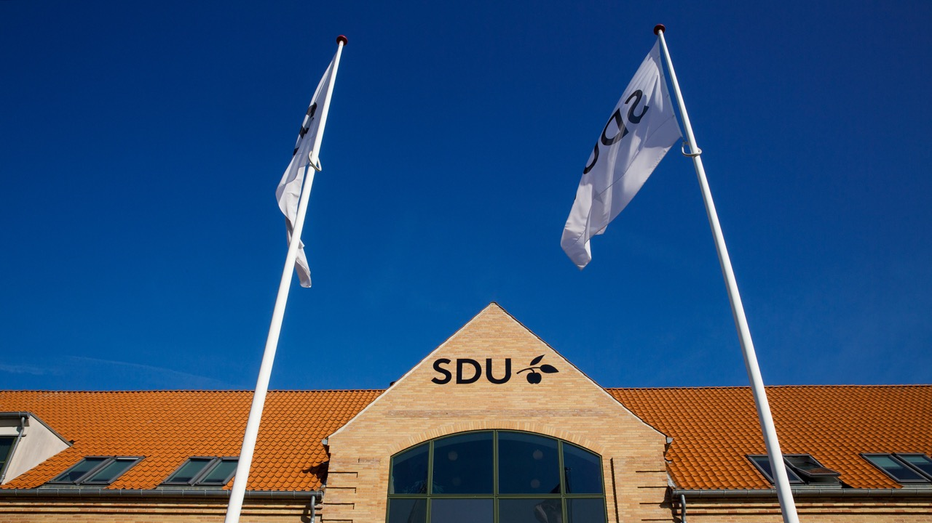
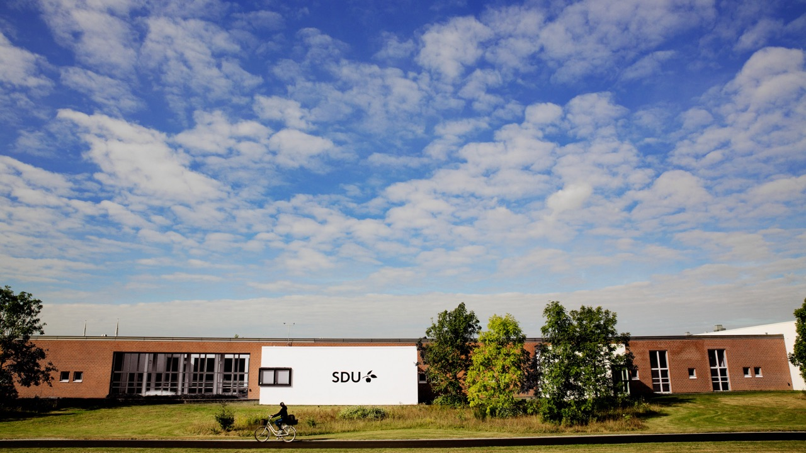

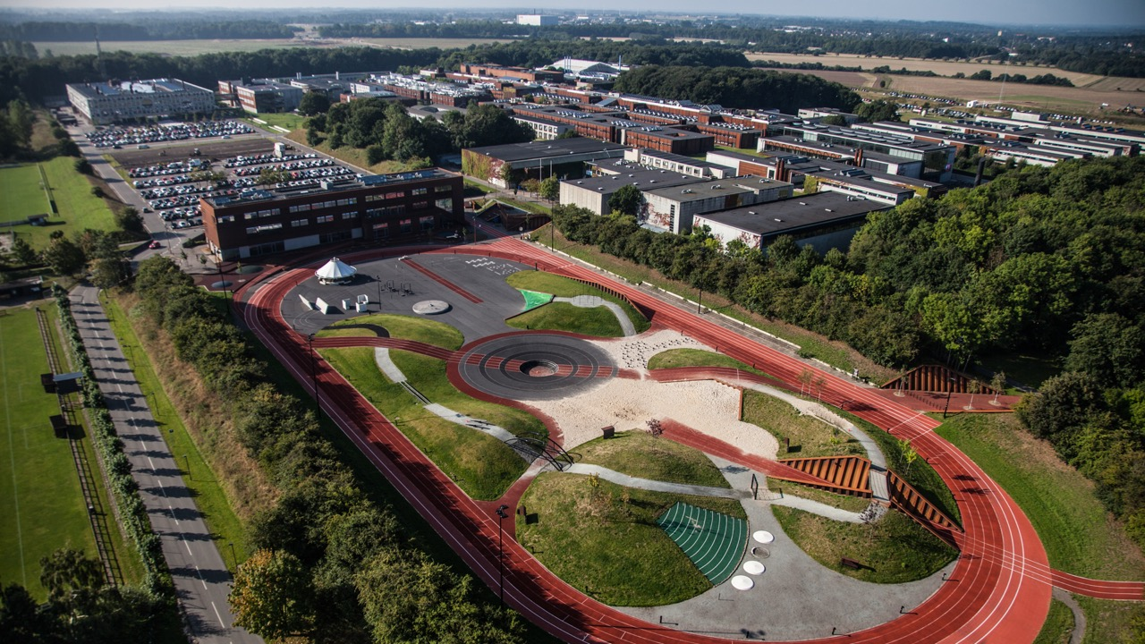
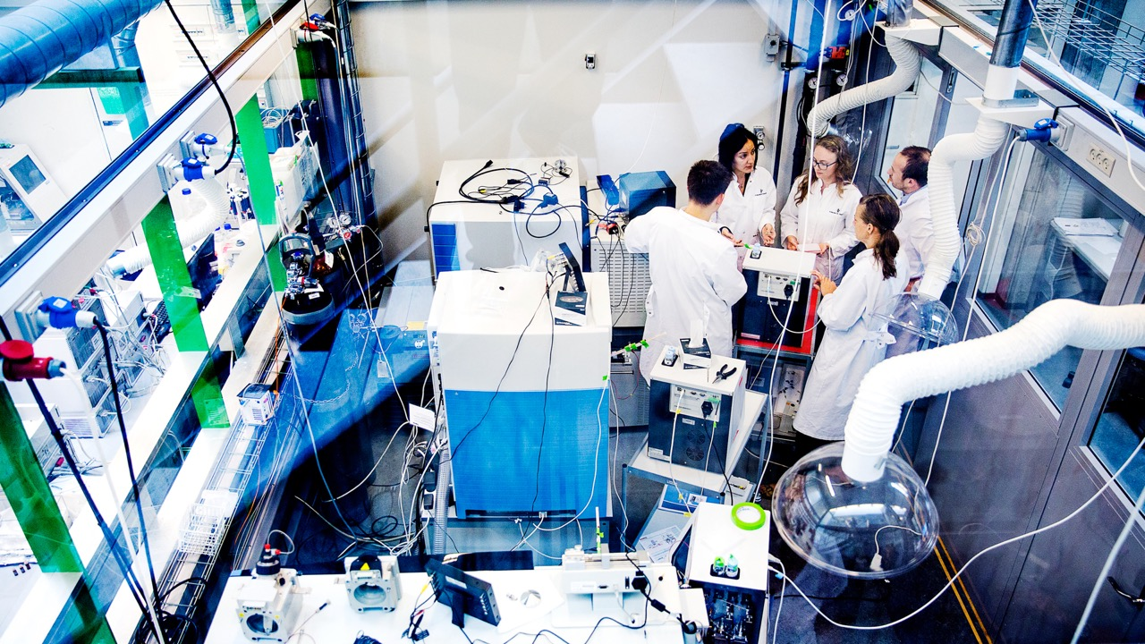

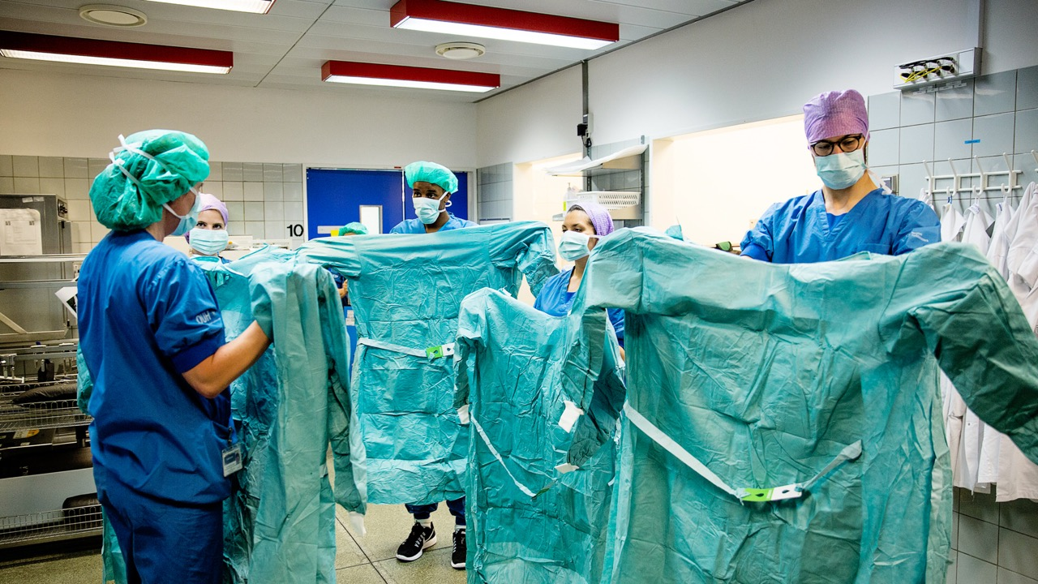
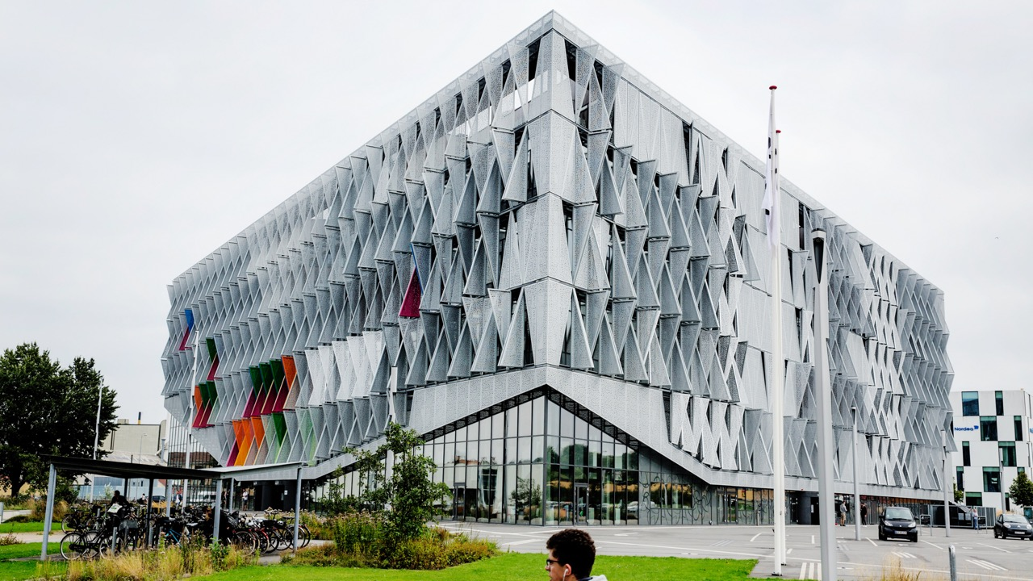

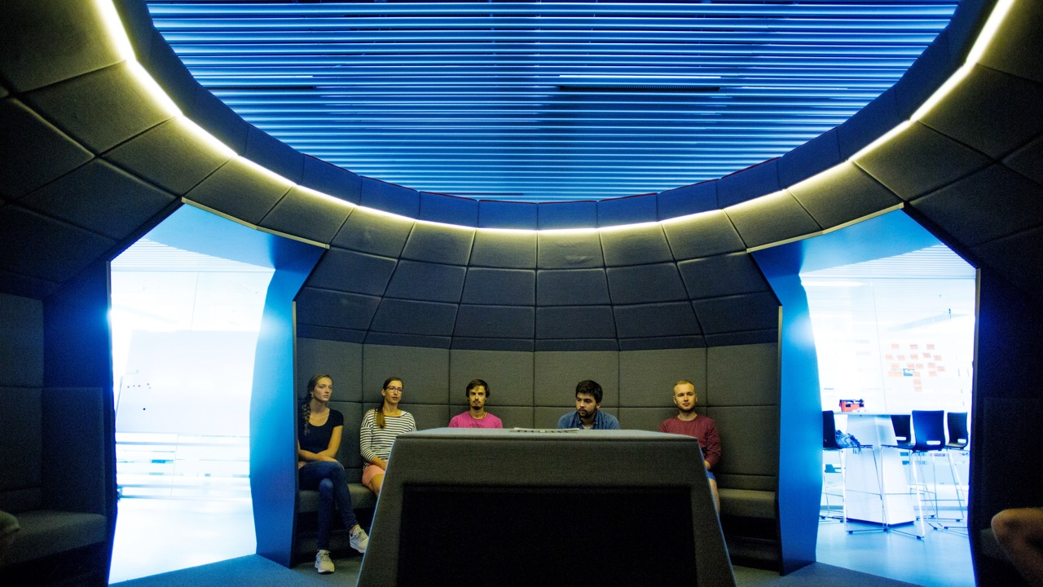




Front page
Information Meeting
Project- and Training Period
2021-04-27
Notes:
Welcome to an information meeting for the course Project- and Training Period, the elective course that offers the possibility of doing an internship with a firm, organization or NGO.

Slide 2
Agenda
Academic
staff
Tentative plan
12:15 – 12:45:
General information by Course Responsible Michael Christensen
12:45 – 13:15:
Information/Tips on how to find an Internship by Career Counselor Marie Sindberg Jensen, SDU RIO
13:15 – 13:30:
Q&A
Organization
Part I
Motivation
Structure
Academic content
Process
RIO
Administration
Notes:
You have likely seen the tentative plan.
I’ll try to keep it brief to allow for more questions towards the end.
Please write your questions down as we go, so that you may ask them later, perhaps put them directly in the chat.
PTP is not the typical course in terms of lecturing, reading, etc., and even managing it from our side require involvement of different SDU stakeholders.
- Supervisors, profile responsibles, course responsible (me)
- RIO, among other responsibilities do career consulting (Marie)
- Study administration, study board (Caroline, here as well?)
Since there are so many capabilities involved in running this, you may see today and if you engage with us later,
that we may refer you to other and more capable coworkers when you contact us.
For my part…

Slide 3
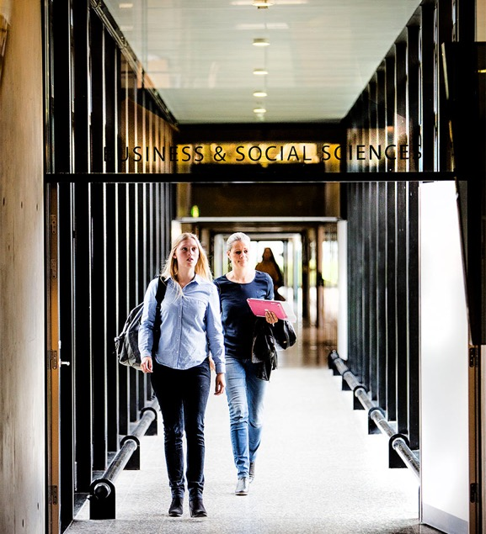
Motivation
SDU
The Relevance Agenda: create value to society
Link quality in research & education with applications
Study board and recruitment panel recommend
STUDENTS
Get experience
Expand your network
Get an application perspective on theory
Learn tools to manage your career
FIRMS
Fresh perspective on a problem
Cheap and flexible additional labor
Screening of future employees

Slide 4
Structure
Solution of specific problem(s) in firm
Elements of the course
(10 ECTS)
Work 200 hours in firm or organization
Write a report (max 40 pages, 9 ECTS, 7-point grade scale)
Participate in workshops (1 ECTS, pass/fail)
(20 ECTS)
Work 370 hours in firm or organization
Do a literature review (250 pages)
Write a report (max 50 pages, 19 ECTS, 7-point grade scale)
Participate in workshops (1 ECTS, pass/fail)
Report with a reflexive analysis
4 Career Management Skill workshops

Slide 5
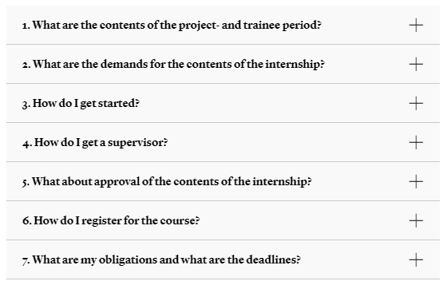
Process
How to get started?
Read the guide on SDU’s web page (link below)!
Main steps to get you started:
Find an internship (own network, SDU job bank, or RIO)
Apply for supervisor (file preliminary project description)
Get supervisor agreement approved (same form)
Register for the course (Student Self Service)
The digital form used for both step 2 and 3 is on the web page.
Project and Training Period on SDU web
https://mitsdu.dk/en/mit_studie/kandidat/candmerc_odense/uddannelsens_opbygning/muligheder/project+and+trainee+period

Slide 6

On 20 ECTS version
Offered on the following profiles:
Brand Management and Marketing Communication
Global Marketing and Consumer Culture
Human Resource Management
Innovation and Business Development
International Business and Management
International Business and Marketing
Strategy and Organization
Cannot be combined with:
10 ECTS version
seminars

Slide 7
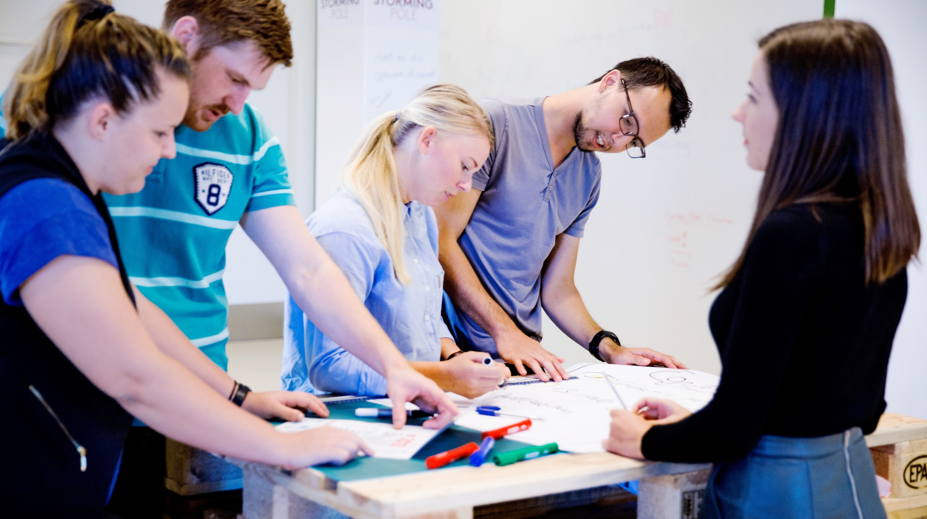
RIO
Notes:
RIO tasks:
Guidance of researchers on research collaborations.
Advice on commercial and legal questions.
Guidance on entrepreneurship.
Career counselling.
Operation of an incubator environment at SDU Entrepreneurship Labs.

Slide 8
Thank you for your attention

