Slide 1
Project & Trainee Period Short introduction on how to find a project organization & Career Management Skills
Tine Lynfort Jensen
Career Consultant
SDU RIO

Slide 2
Why choose a Project and Trainee Period?
Hands-on experience applying theory to practice
Concrete working experiences and awareness of your own skills and how you can contribute to an organization
Insight into organizations and job functions
Understanding business processes, what kind of taks suits you, career possibilities
Develop and expand your professional network
Also an opportunity to collaborate beyond the period
Develop your CV
Sharpen your academic and professional profile - internships count as experience for employers

Slide 3
What would you like to gain from a Project & Trainee Period?
Need to find an organization and tasks that matches your study profile
Consider:
Is there a specific subject-related area you would like to work with in a practical setting? (e.g. green marketing, HR in start-ups, financial strategies, etc)
Is there a specific business area or sector you would like to learn more about? (e.g. robots, data science, event industry, governance institutions, etc)
Size of organization – small, medium, big, global?
Type of organization – private, public, NGO or…?
Where – close to home or…?
Are you already part of an organization that might be relevant – or know somebody in an interesting organization?

Slide 4
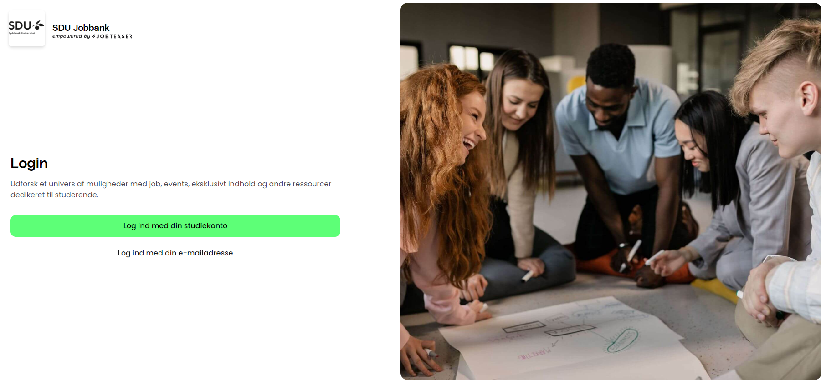
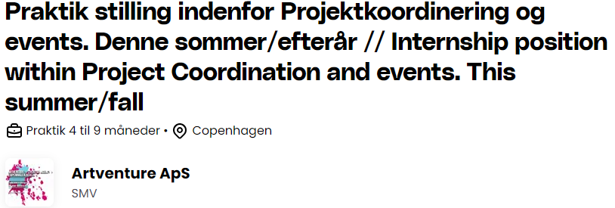
Use the platform SDU Job bank
New internship posts every week
https://connect.jobteaser.com

Slide 5
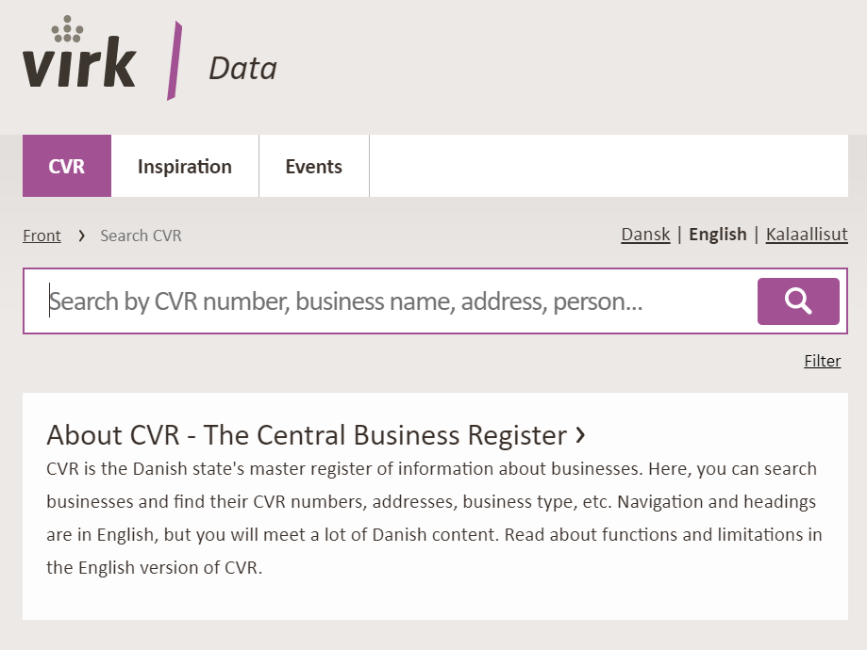
Apply unsolicited – do your own reseach
SDU Jobbank
Also look at student jobs, projects and full time positions – possible openings
Other job portals, eg. Jobindex
LinkedIn: companies and other cand.merc.-candidates
Alumnet, SDU: find alumni that could help you
National and local media
Databases – the library can help
Use your existing private and professional network
Notes:
LinkedIn:
Søg på virksomheder eller på HA/Cand.merc-dimittender.
Kig geografisk bredt og søg uopfordret

Slide 6
How can the Career Services help you?
Get feedback and inputs on your thoughts:
Where and how do I find relevant posts and organizations?
How do I contact an organization?
How do I communicate my competences?
How do I make a targeted application and CV?
How do I prepare for a dialogue with the organization?
How can I use this experience as a career strategy?
Go to mitsdu.dk – career paths
Online info om internships or book a talk with us:
https://mitsdu.dk/en/mit_studie/kandidat/candmerc_odense/karriereveje/find-en-praktik-eller-studiejob

Slide 7
My advices to you
Do it – its a great career move!
Start the planning early – finding an organization takes time
Use SDU RIO services – career talk, online resources

Slide 8
Career Management Skills

Slide 9
What is Career Management Skills?
An online 4 module course in connection to your Project and Trainee Period
Facilitated by a Career Counselor from SDU RIO
1 synchronous webinar in the beginning of the semester
Rest of the activities are asynchronous
The purpose of the course is:
Inspire you to get the most out of your project period career wise
Increase your chances of getting a job after graduation
Prepare you to make decisions about your career
Topics centered around your experiences in your project organization
Competences
Networking
Career strategies and tools to apply for jobs

Slide 10
From the Course Description (10, 20 ECTS)
Throughout the Career Management Skills modules, the students will bring their competences and resources to action in their project company as well as reflect on their experiences during the semester.
The themes of the course include knowledge on competences, awareness of one’s own competences, network and cooperative relations, strategy and planning as well as an understanding of the current and future labor market.

Slide 11
How is it organized?
Placed on your Its learning room
Concrete tasks – individual and collaborative
Reflections, discussions in Itslearning room
Activities in your project organization - hands on experience with the topics from the course
Feedback and interaction with fellow students and SDU RIO consultant
Active participation – do minimum 3 out of 4 modules and work actively with tasks

Slide 12
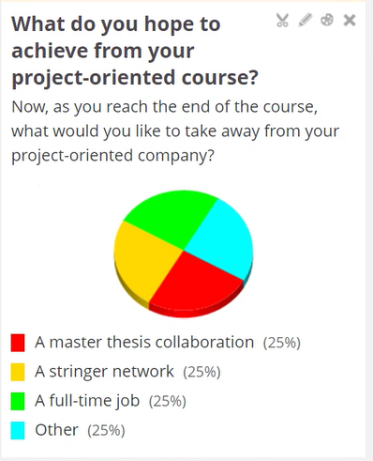
Student inputs from this semester

Slide 13
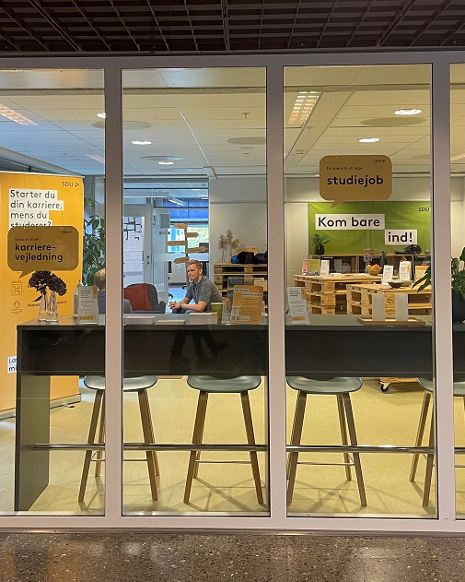
Thank you – and hope to see you again!
Tine Lynfort Jensen
lynfort@sdu.dk
The Career Counseling at SDU
karriere@sdu.dk
Meet us in Zone E at Gydehutten 10-14 across U82

