Slide 1
Project & Trainee Period
Short introduction on how to find a project organization
&
Career Management Skills
Tine Lynfort Jensen
Career Counselor
SDU RIO
SDU Study Job & Career

Slide 2

Why choose a Project and Trainee Period?
Hands-on experience applying theory to practice
Insight into organizations and job functions
Develop your professional network
Develop your CV
Internship counts as experience for employers

Slide 3

What would you like to gain from a
Project & Trainee Period?
Find an organization and tasks that matches your study profile
Consider:
Is there a specific subject-related area you would like to work with in a practical setting? (e.g. green marketing, HR in international organizations, financial strategy development, etc)
Is there a specific business area or sector you would like to learn more about? (e.g. robots, data science, event industry, governance institutions, etc)
Size of organization – small, medium, big, global?
Type of organization – start up, private, public, NGO or…?
Where – close to home or…?
Are you already part of an organization that might be relevant – or know somebody in an interesting organization?

Slide 4
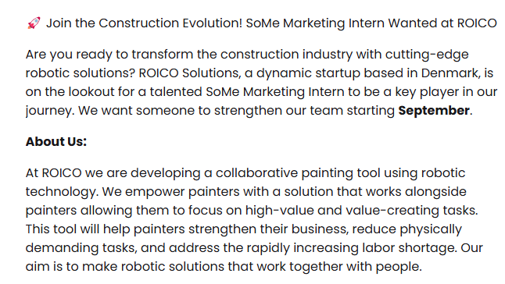
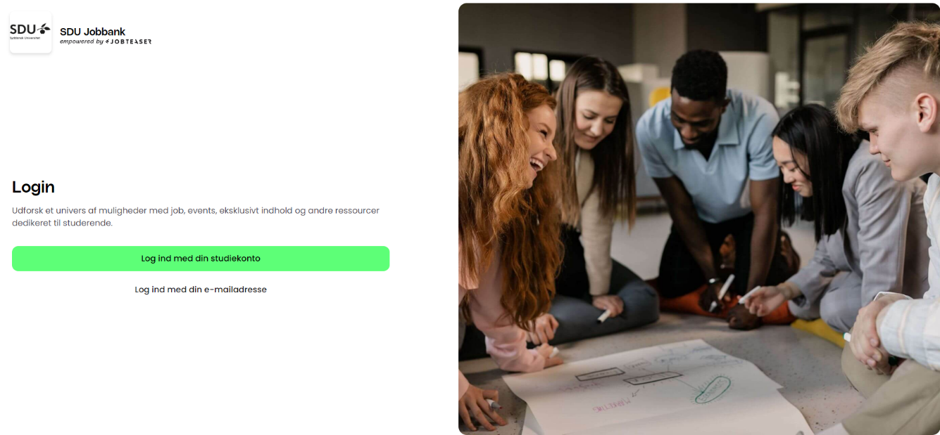
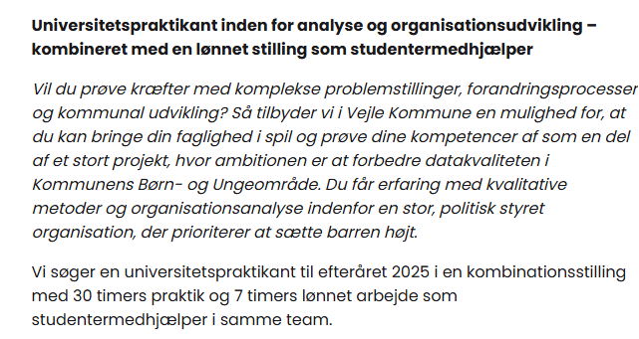
Use the platform SDU Job bank
Organizations are searching right now
https://connect.jobteaser.com

Slide 5
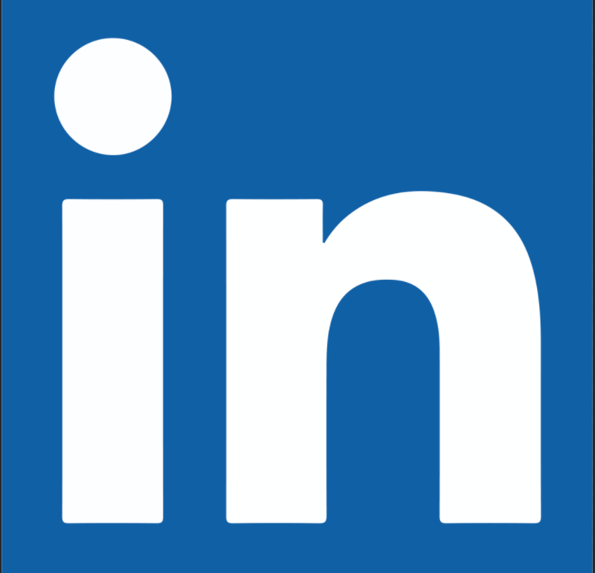
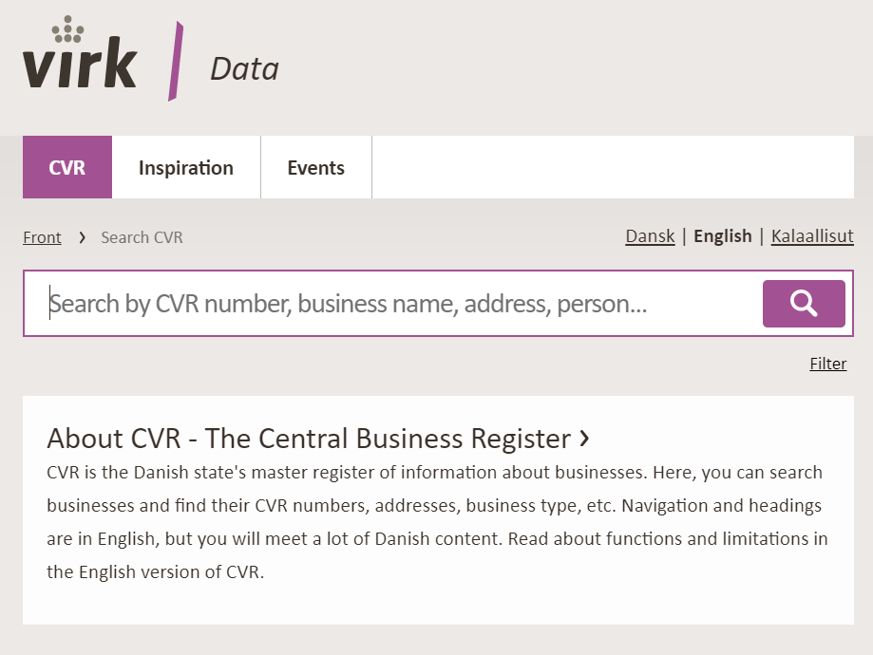


Apply unsolicited – do your own reseach
SDU Jobbank
  Also look at student jobs, projects and full time positions – possible openings
Notes:
LinkedIn:
Søg på virksomheder eller på HA/Cand.merc-dimittender.
Kig geografisk bredt og søg uopfordret

Slide 6

We can help you
  Where and how do I find relevant posts and organizations?
  How do I contact an organization?
  What do I have to offer as an intern?
  How do I make a targeted application and CV?
  How do I prepare for a dialogue with the organization?
  How do I make an agreement with the organization?
Go to mitsdu.dk – career paths
Online info om internships or book a talk with us:
https://mitsdu.dk/en/mit_studie/kandidat/candmerc_odense/karriereveje/find-en-praktik-eller-studiejob

Slide 7
My advices to you
Do it – its a great career move!
Start the planning early – finding an organization takes time
Use SDU RIO services – career talk, online resources

Slide 8
Career Management Skills
A part of your Project and Trainee Period

Slide 9

What is Career Management Skills?
An online 4 module course in connection to your Project and Trainee Period
Facilitated by a Career Counselor from SDU RIO
  1 synchronous webinar in the beginning of the semester
  Rest of the activities are asynchronous
The purpose of the course is:
  Inspire you to get the most out of your project period career wise
  Increase your chances of getting a job after graduation
  Prepare you to make decisions about your career
Topics centered around your experiences in your project organization
  How to activate your skills and competences
  Networking
  Career strategies and tools to apply for jobs

Slide 10
From the Course Description (10, 20 ECTS)
Throughout the Career Management Skills modules, the students will bring their competences and resources to action in their project company as well as reflect on their experiences during the semester.
The themes of the course include knowledge about competences, awareness of one’s own competences, network and cooperative relations, strategy and planning as well as an understanding of the current and future labor market.

Slide 11

How is it organized?
Placed on your Its learning room
Concrete tasks – individual and collaborative
Reflections, discussions in Itslearning room
Links to activities in your project organization
Feedback and interaction with fellow students and SDU RIO counselor
Active participation – do minimum 3 out of 4 modules and work actively with tasks

Slide 12
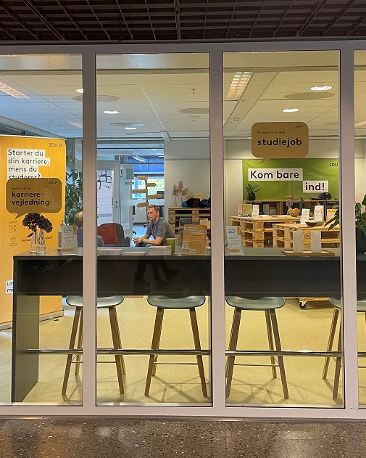
Thank you – and hope to see you again!
Tine Lynfort Jensen
lynfort@sdu.dk
The Career Counseling at SDU
SDU Study job & Career
karriere@sdu.dk
Meet us on Gydehutten 10-14 across U82

