Slide 1
Seminar in Business Economics Fall 2017
Information and advice
Jan Møller Jensen,
Department of Marketing and Management

Slide 2
Agenda
Formalia (home page and course description)
Remember to register for the course
Choice of topic and group formation (no later than 1. of May)
Filling out the digital form with group members and choice of two topics
Blackboard-forum to seek potentiel group members
(‘lonely’ students are grouped administratively after 1. of May)
What is a good topic?
Supervision and writing process
Handing in and oral defense of your seminar project
Questions?

Slide 3
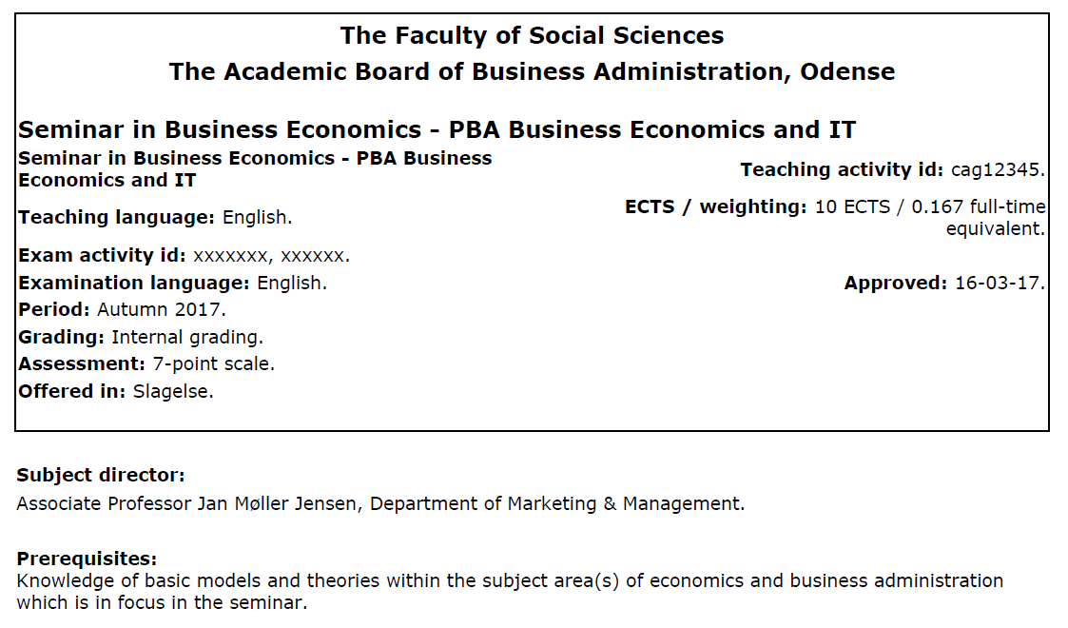

Slide 4
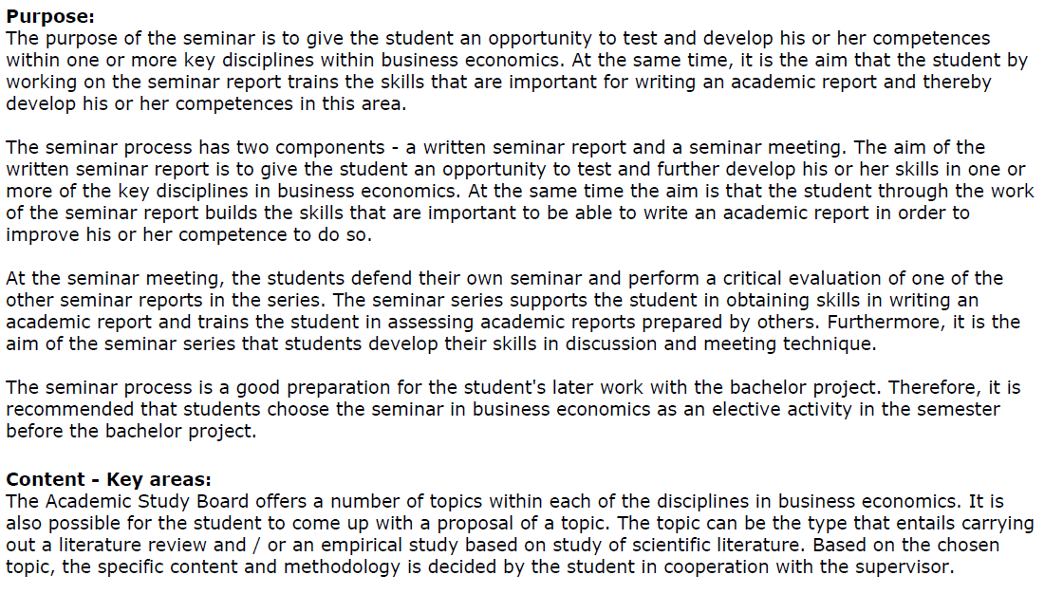

Slide 5
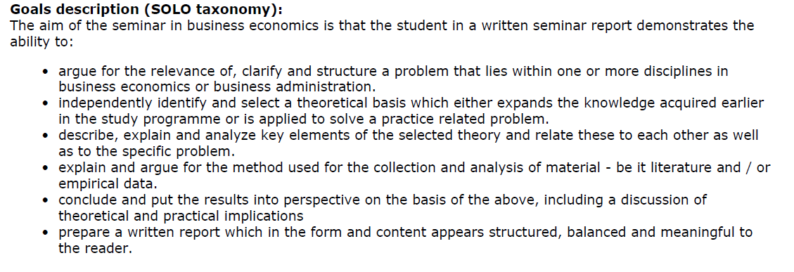

Slide 6
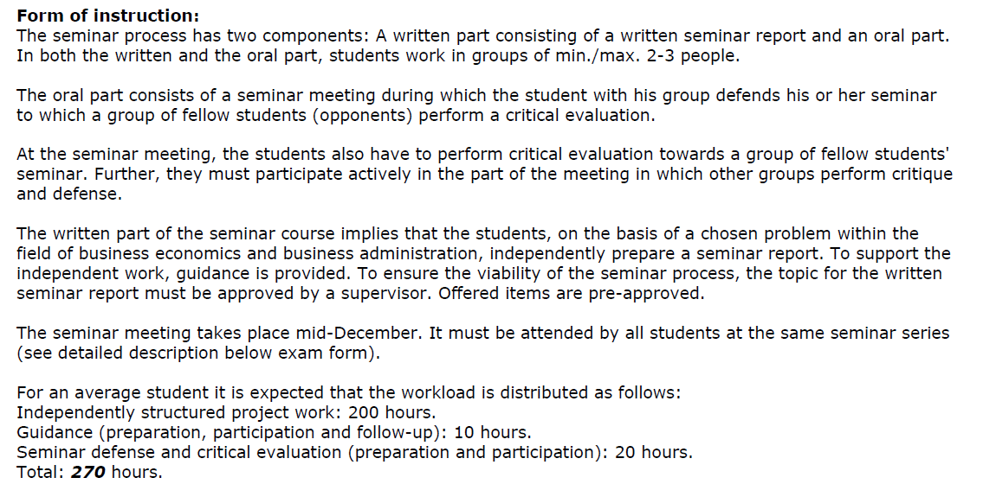

Slide 7
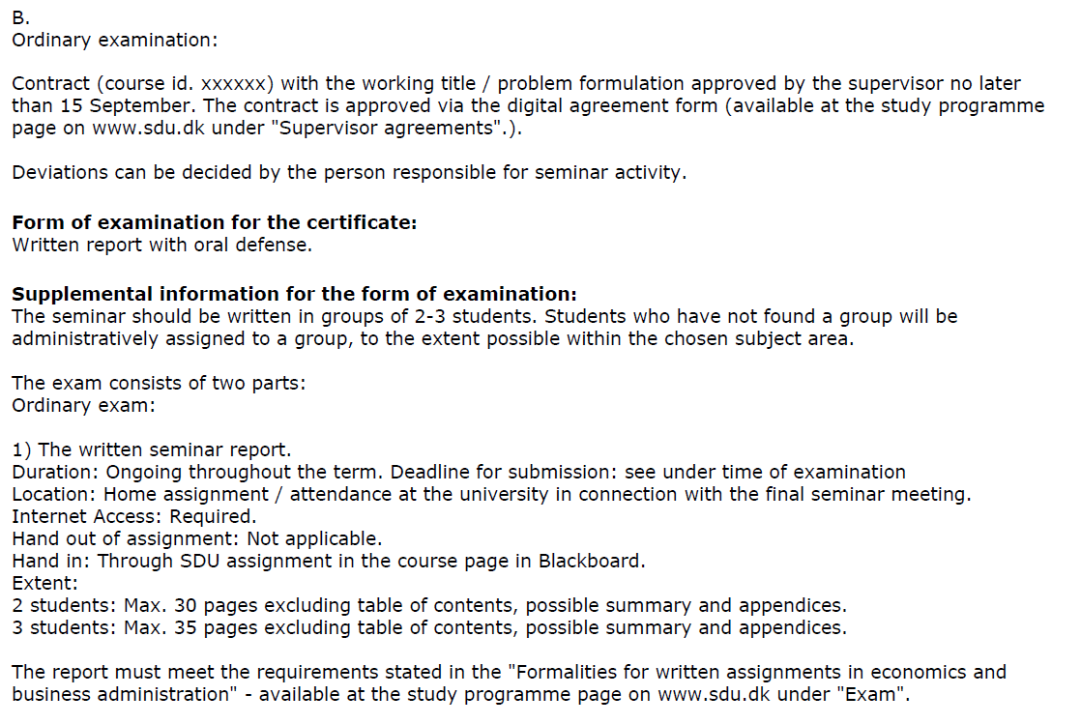

Slide 9
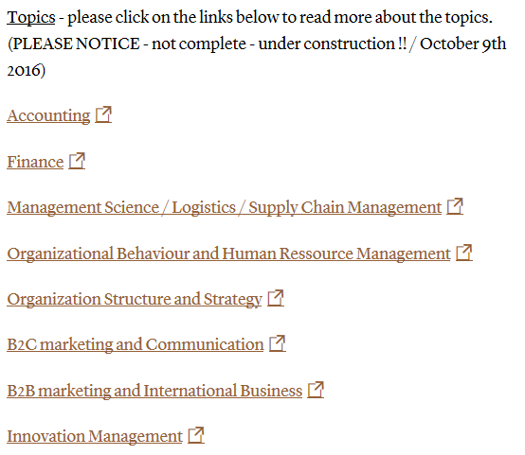
Choice of topic?

Slide 10
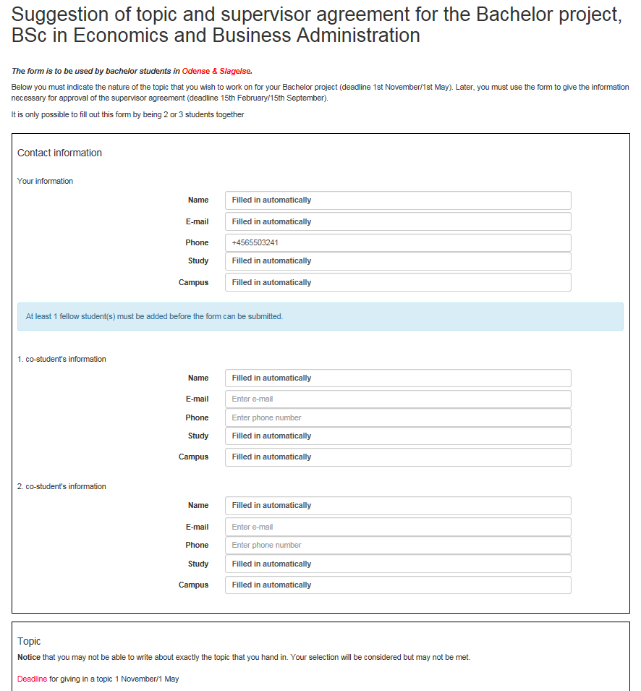
Filling out the digital form?

Slide 11
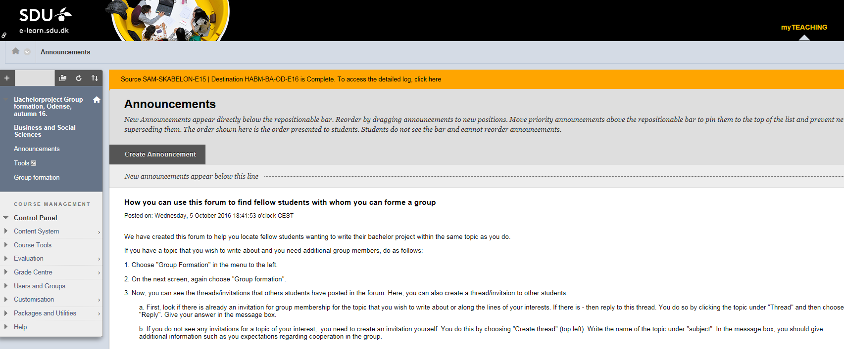
There will be created a forum to let you locate fellow students to form group with.
It will be like the one below but named Group formation, Seminar in Business Economics

Slide 12
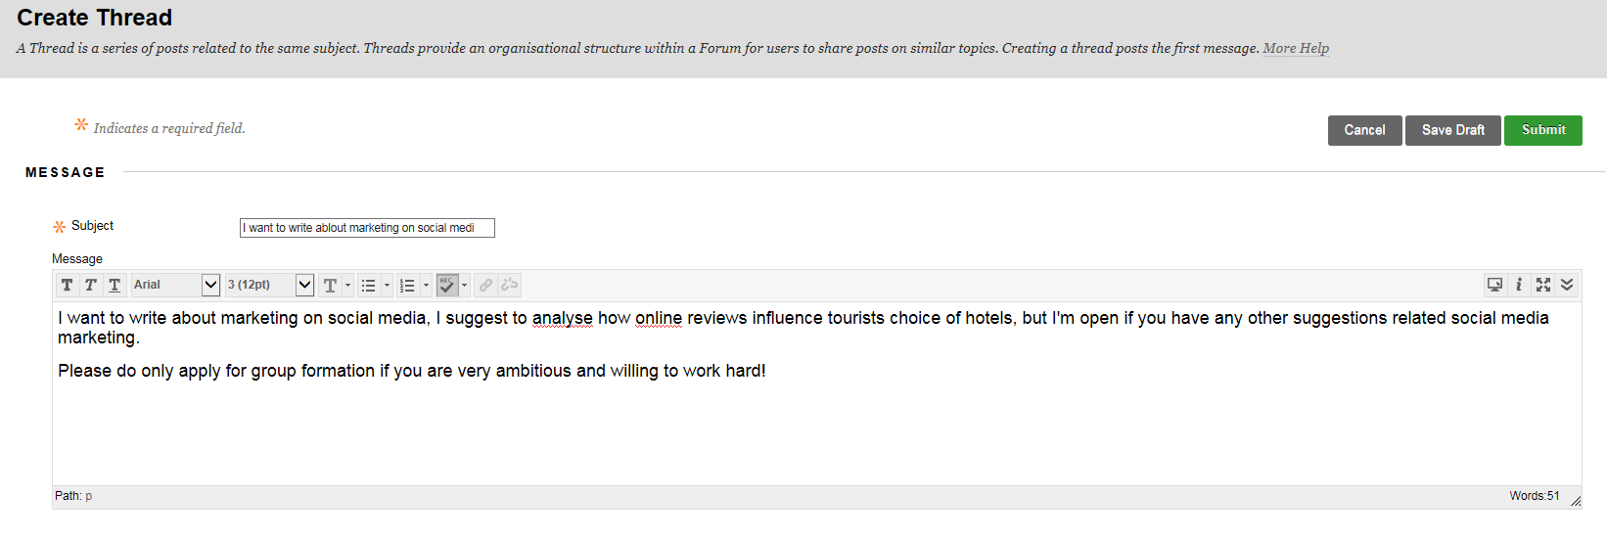

Slide 13
What is a good topic?
almost no limits to the choice of topic (Business Economics)
theoretical, empirical and practical aspects
the bachelor project may be an important ‘sales object’ in your job application
select a topic related to your interests, competences and perhaps career goals
or planned Master program
you may suggest a topic/problem statement yourself, but then you must include
a prelimenary problem statement and research question(s)
expected theory and methods to solve the problem
draft for expected structure of the project
be realistic about. ambitions, resources and time?

Slide 15
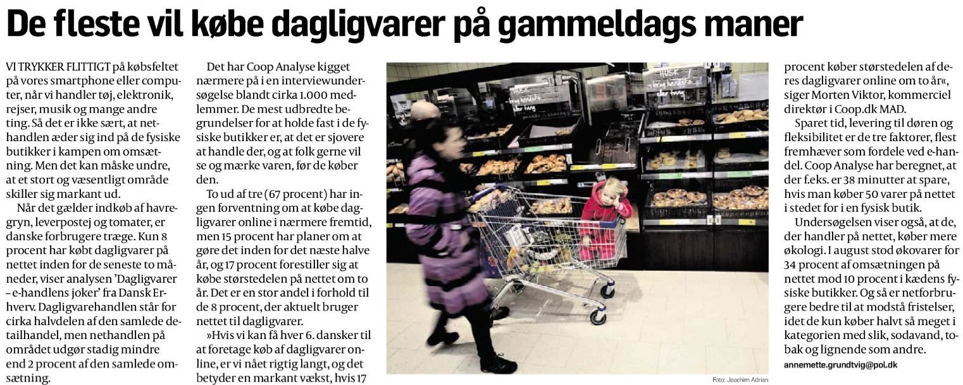
How has e-commerce developed on the FMCG market in Denmark?
What are the motivations and barriers to consumers’ adoption of
purchasing groceries online?

Slide 16
What if your topic(s) are not approved?
Then the electronic form is rejected and you will be informed that you need to suggest new topics within another subject area.
Do that by filling out a new electronic form

Slide 17
What does it take to write a good project?
Embarking on the process of thesis writing is akin to training for a marathon. It takes persistence and hard work,
but in the end, while leaving you thoroughly drained,
will also leave you feeling very accomplished.

Slide 18
How to write a (good) project?
Example of project structure
Problem statement / motivation
Why is this interesting/important?
Audience?
Delimitations?
Methodology
Related work / theory that your work is based on
Research design
Results
Conclusion/discussion/perspective

Slide 19
Supervision - a few things to remember
Agree upon the process at the first meeting:
How many pages will your supervisor read, if any
How long in advance should you send your text / questions to your supervisor?
It is not a good idea to get supervision without being prepared.
Prior to the meeting ( two- three days in advance) send the questions you want to discuss at the meeting
Make sure you ask exactly what you are unsure about
Make notes of the comments and suggestions (mail to supervisor?)
In other words, please use your time
with the supervisor wisely!

Slide 20
Handing in and the oral exam
Maximum of 30 pages for two students and 35 pages for three students
(additional pages are allowed for front page, table of contents, abstract, reference list and appendices)
Handing in in week 49/50 (to be announced)
The oral examination lasts approx. 30 minutes for projects with 2 students
and 40 minutes for projects with 3 students, including grading and feedback
Start wit a short presentation (approx. 3 minutes) of your work
Not just a summary!
Topic/problem statement and motivation/applications
How did you solve the problem?
How was the process (problems?)
Results and their reliability/validity
Implications for theory and practice
Anything new happened in the period after you turned in the project

Slide 21
?

